Slide 1

“Information Literacy Instruction for Library Professionals”
Tuesday, April 5, 2022, 12:30 – 1:00 PM
Presented by Jess Hoffman,
Instructor for Information Literacy for Library Professionals.
with an introduction by Sharon B. Phillips,
Youth Services Program Manager, New York State Library
Notes:
NOTES

Slide 2
Housekeeping Reminders
Microphones will be muted for this webinar. Please ask questions via chat. Be sure to select “To: Everyone” when posting a question.
If the PowerPoint isn’t formatting correctly on your screen, select “Fit to Screen” under view options.
We will be asking you to complete a brief survey at the end of this program.
This webinar is being recorded and will be archived on the Webinar page of Library Development for future viewing.
Notes:
-So thank you very much for attending our session…we so appreciate you being with us on a Saturday morning.
-One thing before we take questions…the State Library Opinion Survey. We need your input!

Slide 3
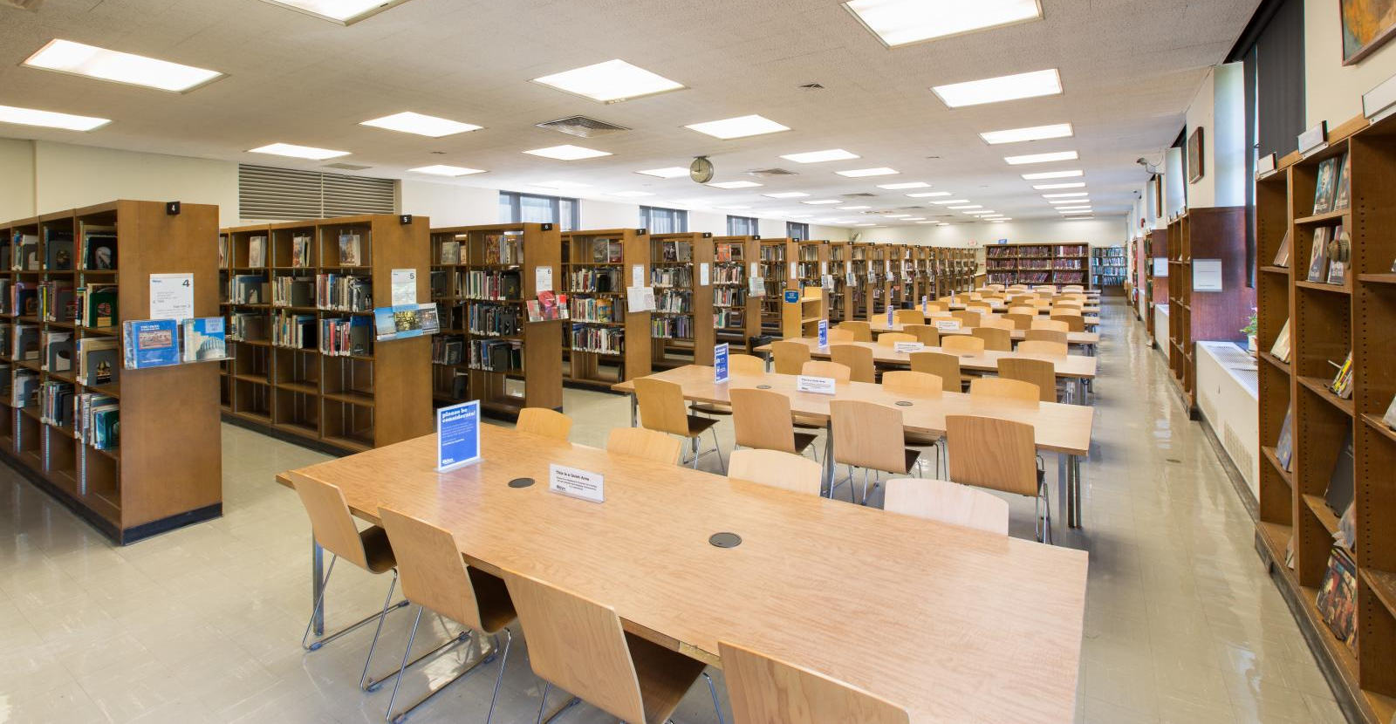
What is information literacy?
“A set of abilities requiring individuals to recognize when information is needed and have the ability to locate, evaluate, and use effectively the needed information.” –American Library Association
Notes:
Define information literacy
Broad concept
Possibly more important than ever before

Slide 4
What is information literacy? (2)
Skills that can be taught
Attitudes that develop over time
A basic human right in the “information age”
Notes:
From the course’s intro to information literacy

Slide 5
What is information literacy? (3)
Identifying information needs
Accessing information
Evaluating information
Applying information
Using information ethically
Notes:
Information literacy skills

Slide 6
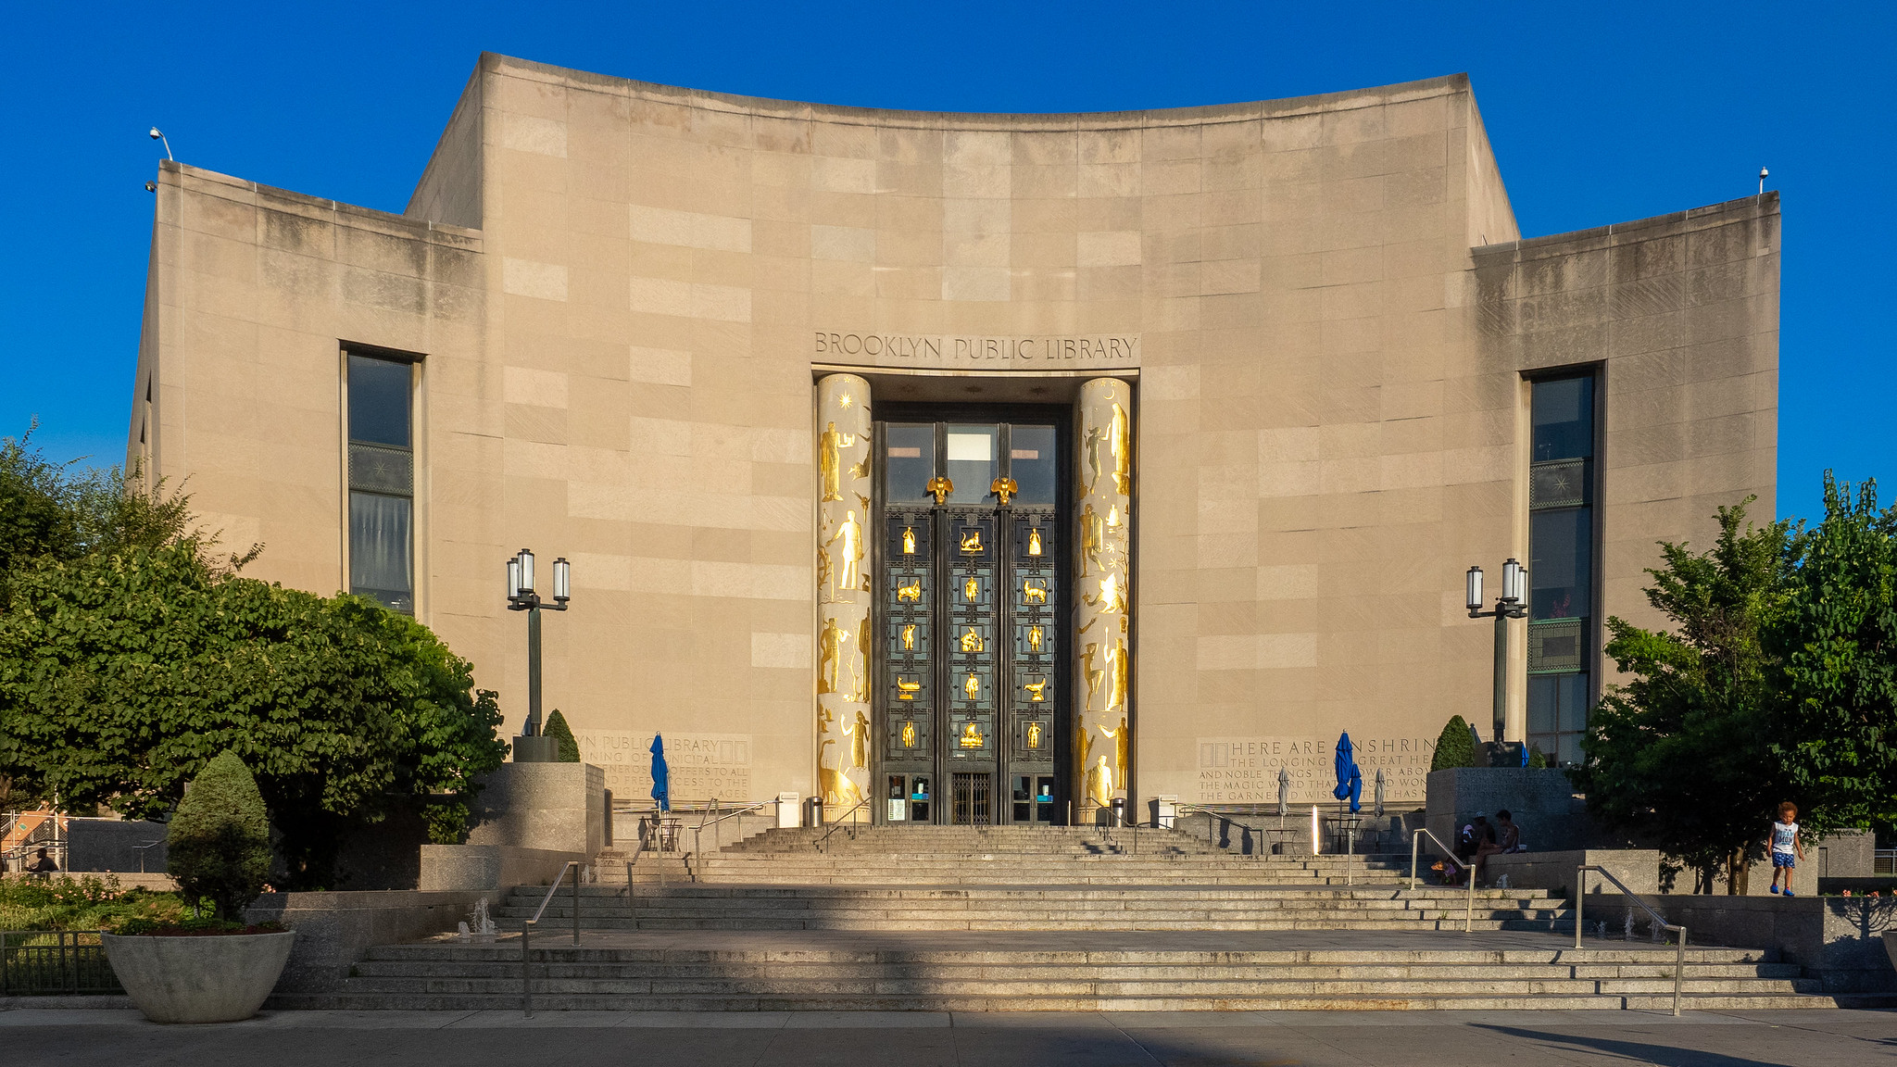
Why is information literacy critical for libraries?
Libraries are information facilities
Adaptable enough to deal with changing information trends
Encourage and facilitate healthy information literacy attitudes
Notes:
It’s our JOB as information professionals to help our patrons navigate the increasingly complex world of information
Healthy information literacy attitudes such as lifelong learning and good information evaluation skills contribute to the sociopolitical health of a community.
NEXT: a poll

Slide 7
How would you rate your overall information literacy?
5 | 4 | 3 | 2 | 1
Excellent | Good | Average | Mediocre | Poor

Slide 8
How would you rate your skills and confidence in teaching and instruction?
5 | 4 | 3 | 2 | 1
Excellent | Good | Average | Mediocre | Poor

Slide 9
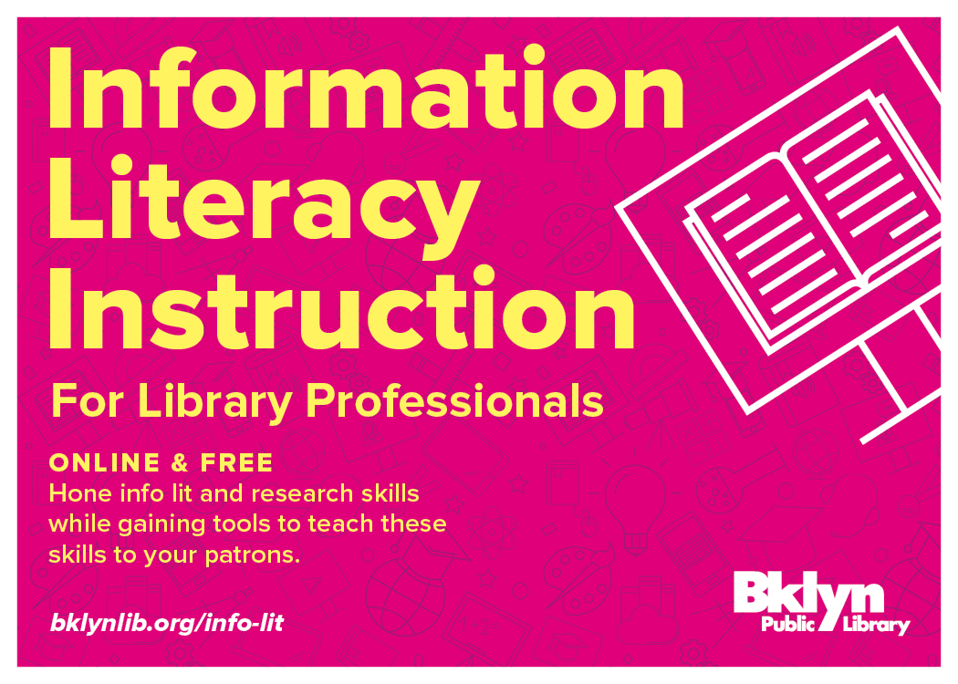
Information Literacy Instruction Course
For ALL library staff in any position at any library with any level of experience
12 hours of continuing education
Online and self-paced
Notes:
For all library staff in any position at any library
12 hours of continuing ed
Online and self paced

Slide 10

Topics Overview
Addresses real-world needs and a prevalent skill gap
Topics covered include:
Research techniques
Information equity
Evaluating information
Social media and free speech
Instructional strategies
Presentation basics
Empathy and crisis management
. . . and more!
Everyone will get something out of it!
Dedicated full-time course instructor
Notes:
Addresses a real-world need and a prevalent skill gap
Everyone will get something out of it - Broad enough to be a good introduction, but in-depth enough that even seasoned and savvy library staff will benefit
Dedicated full time instructor (me) to help you get the most out of the course
Side note: also working on some auxiliary projects including a webinar series through METRO: Info Lit 101

Slide 11
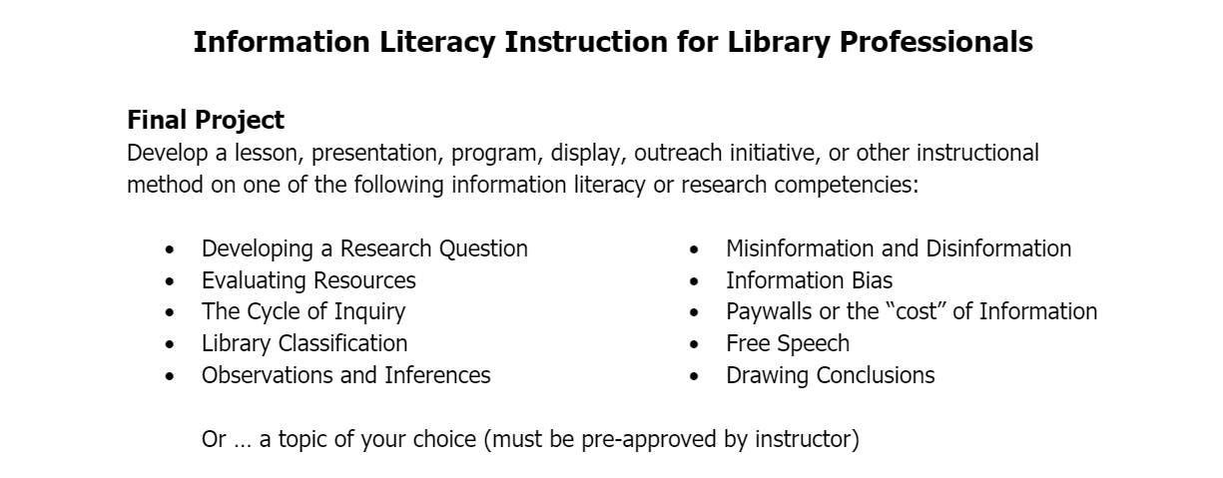
Information Literacy Instruction for Library Professionals
is available until
JULY 31, 2022
Notes:
Final project aims to bring what you learn in the course into your library work
Very flexible
Instructor here to help
Must be in a library setting, must include some information literacy concepts
MUST BE COMPLETED BY JULY 31, 2022

Slide 12
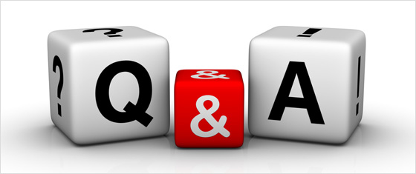
Conclusion
Thank you for participating – any questions?
A survey will be emailed to you shortly – please take a few minutes to respond. We truly appreciate your feedback!
Contact information for speakers:
  Jess Hoffman: jhoffman@bklynlibrary.org
  Sharon B. Phillips: Sharon.Phillips@nysed.gov
Information Literacy Instruction for Library Professionals: http://bklynlib.org/info-lit

