Slide 1
School Library System Annual Report 2020-2021
June 2021
New York State Library
Division of Library Development

Slide 2
General Information
Given the unanticipated operational challenges impacting New York’s libraries, the deadline that school library systems must submit annual reports to the State Library has been extended to November 1, 2021.
To avoid loss of data, only one person at a time should be logged into a library report. Multiple people logged into the same report will cause data to be lost.
Libraries should not have reports from two different years open at the same time.
Systems have one log-in per system. If you are unsure of your log-in, please contact Jeffrey Kirkendall, Jeffrey.Kirkendall@nysed.gov

Slide 3
Helpful Information
Notes:
Highlight reading instructions
Show last years answers
Instructions at top
Question marks for pop up instructions
Print button and show status screen shot, and print
Reports aren’t yet open - NYLINE S notice will go out when reports software is ready.

Slide 4
More helpful information
Instructions intended for more than one question are marked as such.
Reminder: All Notes are now encompassed in one note field (rather than Federal/State/Local).

Slide 5
Part 1 General System Information
System/ Director Information
Supervisor and Superintendent Information
Q1.49 Unusual Circumstances
For the reporting year, has the system experienced any unusual circumstance(s) that affected the statistics and/or information reported (e.g. natural disaster, fire, closed for renovations, massive weeding of collection, etc.)? Indicate Y for Yes, N for N

Slide 6
Part 2 Personnel
Budgeted Positions in Full-Time Equivalents
Salary Information

Slide 7
Changes to Part 2 Personnel
New Questions:
Q2.26 Librarian FTE
Q2.27 Librarian Current Annual Salary
Notes:
Info collected on librarian salary was removed from the report when we removed part 7 and added to part 2

Slide 8
Part 3 System Membership, Outlets and Governance
Public Service Outlets
Board/ Council Meetings
System Board/ Council
Repeating Group #2 Board/Council Member - complete one record for each current voting Board/Council Member. For each vacant position, select "Vacant" in question 1, and enter N/A in questions 2-10 of the repeating group. You may 1) enter the data for the Board/Council Members directly into the survey as usual or 2) send Baker and Taylor the data for this section to be uploaded into Collect. If you choose to send your data for uploading, you must enter the data into the spreadsheet form available in the survey by clicking here. Complete this form and email it to collectconnect@baker-taylor.com.The board president should not be included on the spreadsheet. Please enter board president information in the section above.

Slide 9
Part 3 System Membership, Outlets and Governance cont’d

Slide 10
System Board Council

Slide 11
Part 5 System Services
Catalog
Interlibrary Loan
Continuing Education
Coordinated Services/ Consulting Services
Reference
Special Clients
Fees

Slide 12
Changes to Part 5: System Services- Union Catalog
Q5.14 to 5.19 the following language has been added to the Instructions: “For titles and holdings answer as of the end of the fiscal year. For additions to titles and holdings indicate the number added in the past fiscal year.”

Slide 13
Changes to Part 5 -2

Slide 14
Cumulative number of contact hours auto-calculated
Q5.33 to 5.75 For Continuing Education/ Professional Development questions, an additional question auto-calculates the “cumulative number of contact hours.” (This number reflects the number of participants multiplied by the number of contact hours.)
Reminder-
Provide the total number of sessions for each category. Count each session in a series of programs (e.g., a six–week session training course would count as six sessions.) A session consists of at least one hour of training on one topic. It can consist of one or multiple contact hours.
Notes:
In response to request from
Reminder – restate instructions

Slide 15
Cumulative number of contact hours
PARTICIPANTS: Provide the number of participants for the total number of sessions under each category.
NUMBER OF CONTACT HOURS: A contact hour is defined as a standard one hour (at least 50 minutes) educational period. Please add a Note of explanation if the number of contact hours per session is unclear. For example, if 3 sessions are listed and the total number of contact hours are listed at 16, a Note might say “The training consisted of three days. Two days of training totaling 14 hours plus one two hour session on the third day”.
Notes:
In response to request from SLS Director input
Reminder – restate instructions

Slide 16
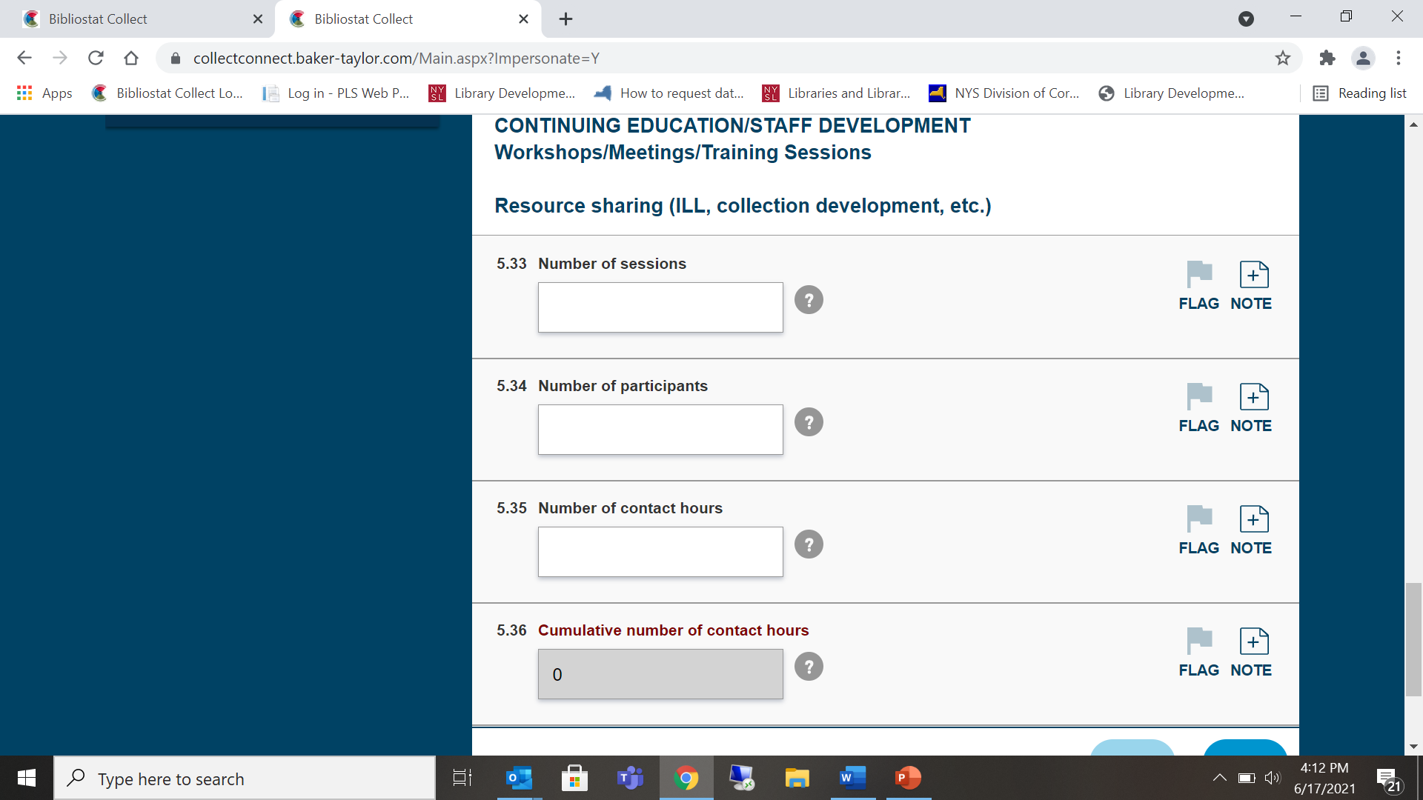
Continuing Education

Slide 17
Consulting and Technical Assistance Services
Q5.95 – 5.96 For Consulting and Technical Assistance Services, have been changed to Y/N responses. The number of contacts will not be required.
Indicate if the system is providing services in the following areas: program content, grant writing, budget, grants administration, legal, building, technology and other areas of expertise. Include contacts between the library system's director, assistant directors, coordinators, and specialists (librarians, consultants, coordinators) of all kinds and your system's member libraries. Visits, e–mail, phone, fax and written correspondence should all be included here."

Slide 18
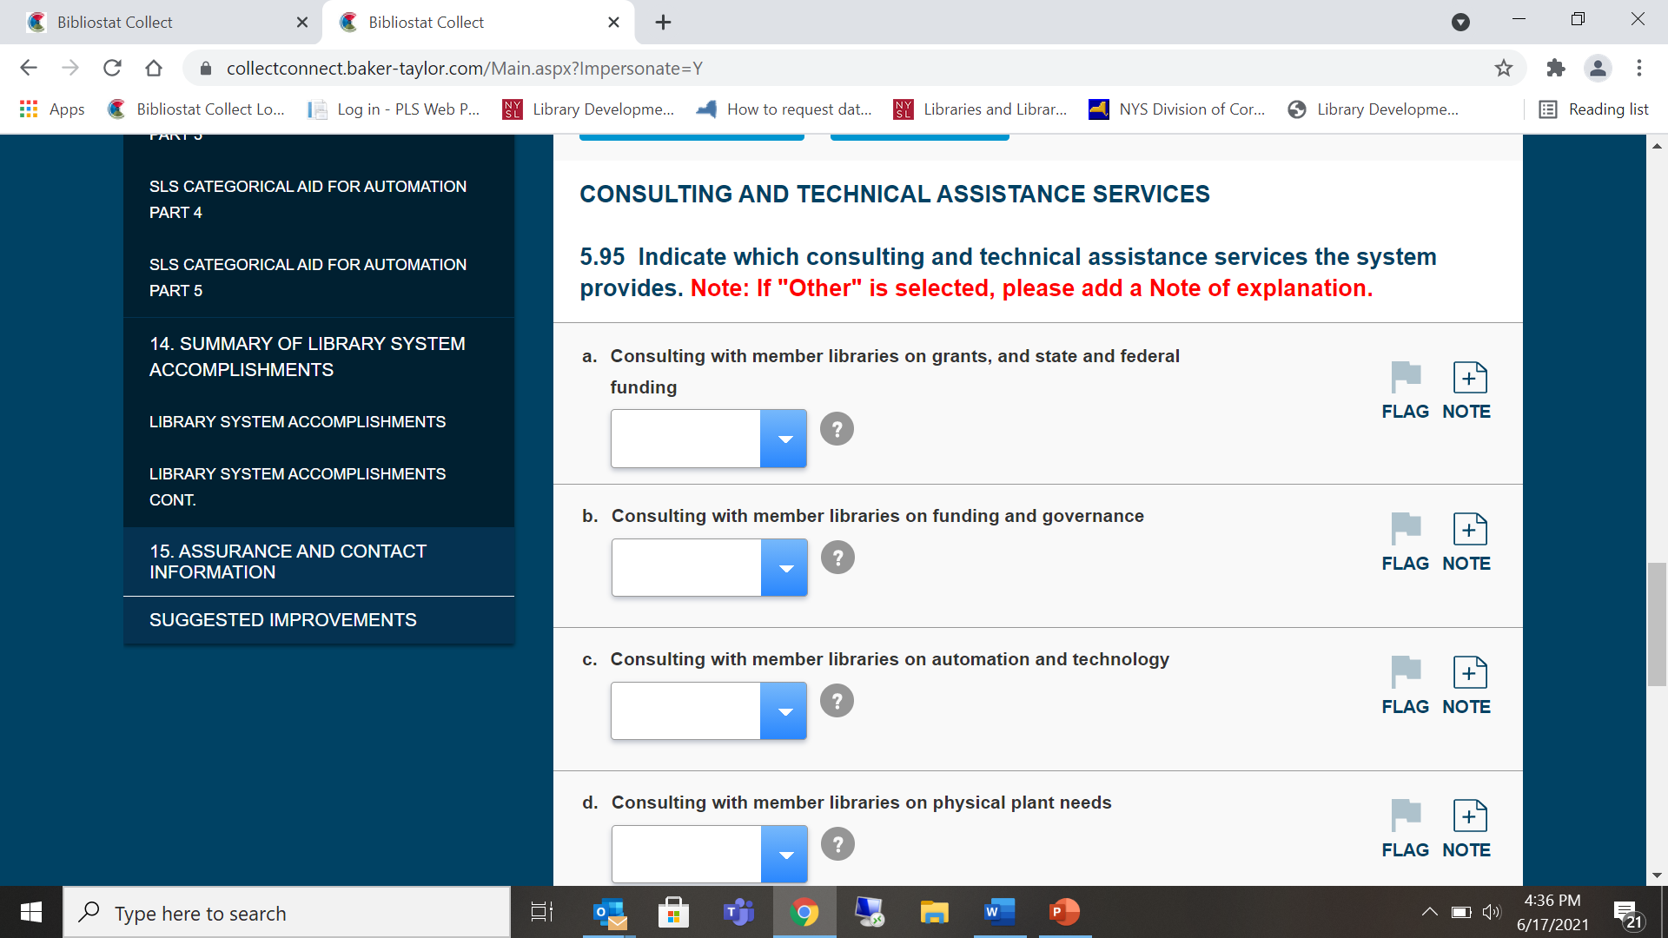
Consulting and Technical Assistance Services cont’d

Slide 19
Reference
New Question:
Q5.97 Regarding the number of Reference Transactions entered, is this an annual count or an annual estimate based on a typical week or weeks? Dropdown choices: CT-Annual Count; ES- Annual Estimate Based on Typical Week(s)

Slide 20
Reference Services

Slide 21
New definition of Reference to align with federal IMLS Definition
Reference
Reference Transactions are information consultations in which system staff recommend, interpret, evaluate, and/or use information resources to help others to meet particular information needs.
A reference transaction includes information and referral service as well as unscheduled individual instruction and assistance in using information sources (including web sites and computer–assisted instruction). Count Readers Advisory questions as reference transactions.

Slide 22
Definition of Reference to align with federal IMLS Definition
Reference
Information sources include
printed and non–printed material;
machine–readable databases (including computer–assisted instruction);
the library's own catalogs and other holdings records;
other libraries and institutions through communication or referral; and
persons both inside and outside the library

Slide 23
The request may come
in person,
by phone,
by fax,
by mail
by electronic mail, or
by virtual reference
See Instructions for more detailed information

Slide 24
Part 6 Operating Funds Receipts -1
Report receipts and disbursements from Operating Aid, Supplementary Aid and Categorical Aid for Automation.
Reports are cash–in/cash–out reports and reflect only money actually received and disbursed by the system.
Do not include accruals for anticipated income and/or disbursements.

Slide 25
Part 6 Operating Funds Receipts -2
The value of existing assets (e.g., real property, endowment or investment accounts) does not appear on the Financial Report.
Do not estimate receipts and/or expenditures for any item furnished free, such as rent, utilities, or volunteer help.

Slide 26
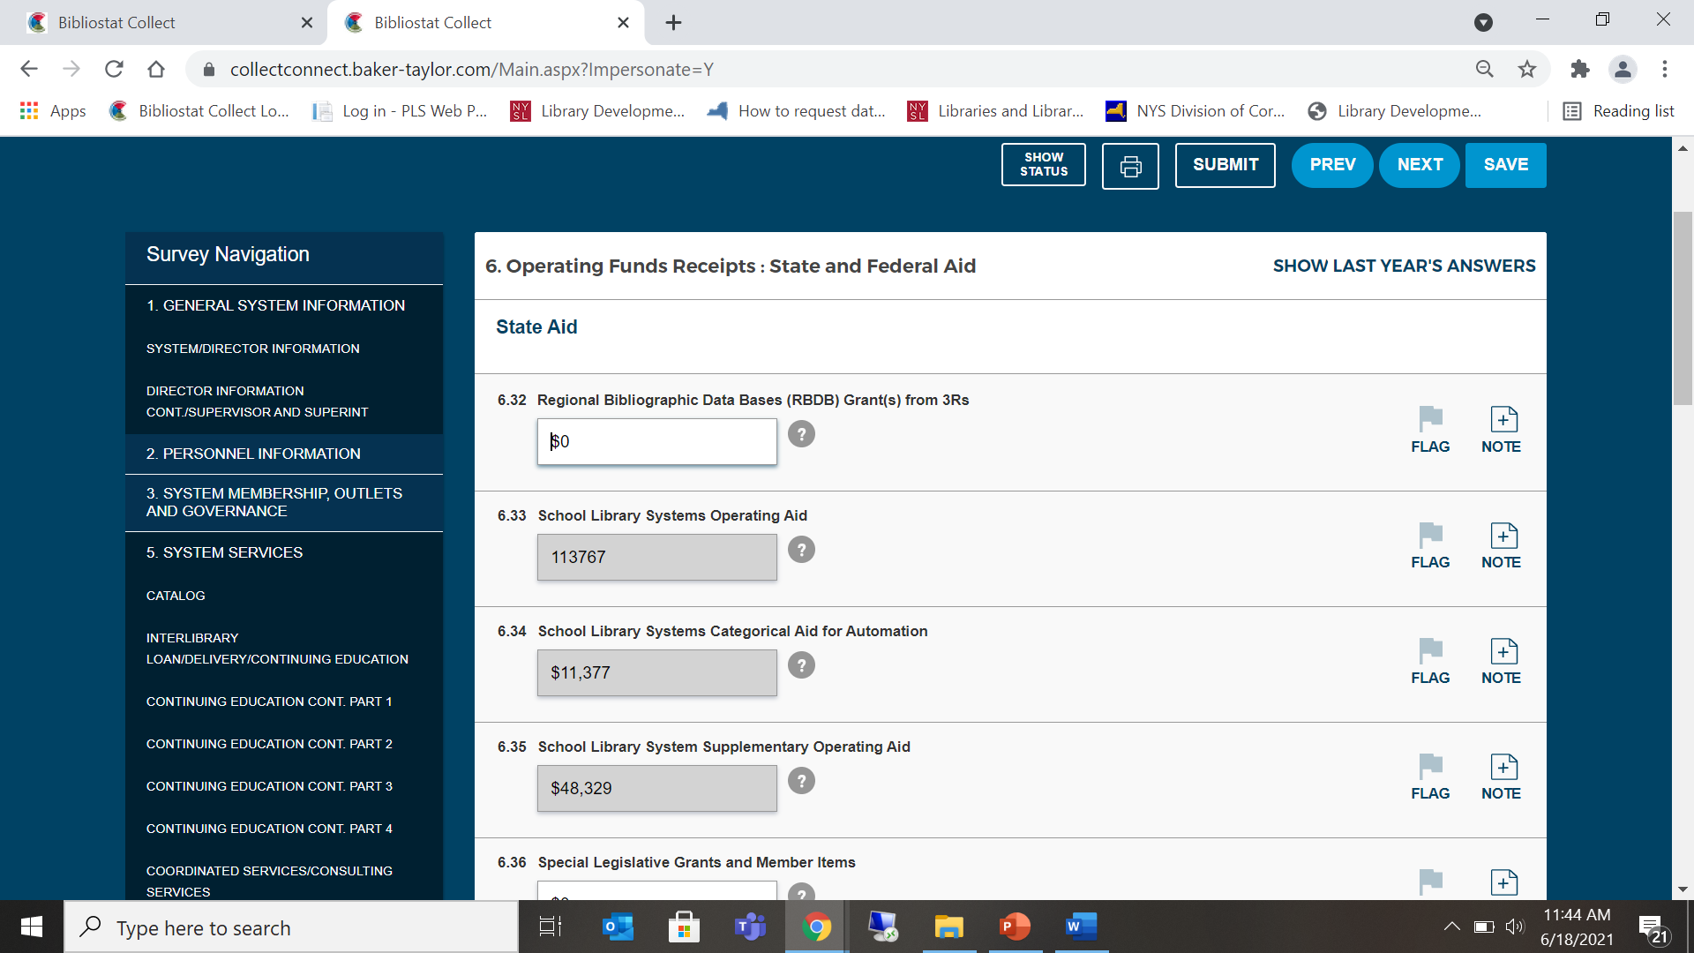
Part 6 Operating Funds Receipts -3
Notes:
Fields are pre-filled for 2020 aid

Slide 27
Part 6 Operating Funds Receipts COSERS
If funding from COSERs is used to support the SLS Program include the total amount here. This could include, but is not limited to: the salary and/or benefits of the SLS Director and/or the SLS clerical position, travel expenses to attend training, materials provided in training, etc. otherwise enter N/A.
There may be additional COSER funds received by the SLS. Include only the COSER funds that go to support the SLS Program.

Slide 28
Part 6 Operating Funds Receipts Beginning Balance
6.66 Total SLS Beginning Balance (Operating, Supplemental and Automation Aid Funds) (as of July 1, 2020). For School Library Systems, opening balance on July 1, 2020 must be the same as the June 30, 2020, closing balance reported in Q12.4 of the 2019-20 annual report.

Slide 29
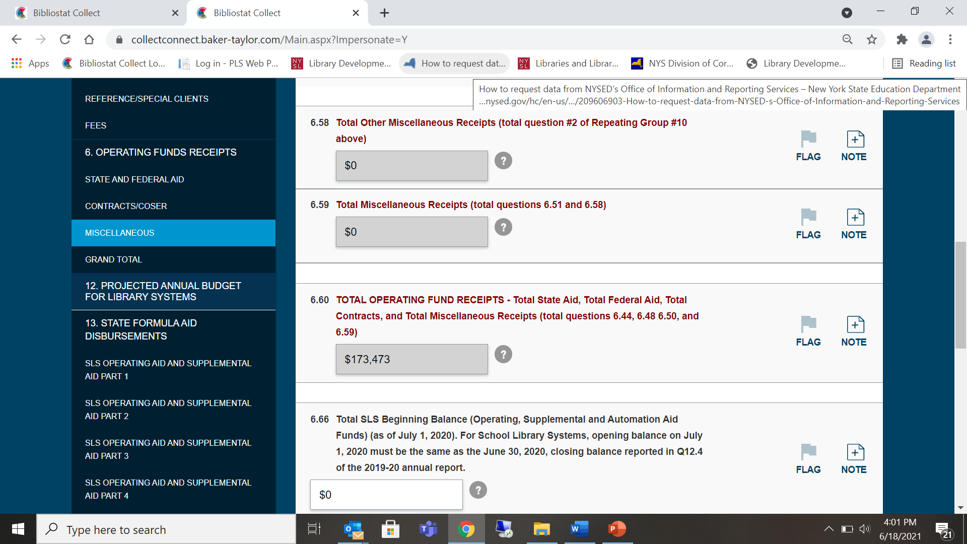
Part 6 Operating Funds Receipts

Slide 30
Changes to Part 7
Operating Funds Disbursements is Eliminated!
Notes:
Add fireworks!

Slide 31
Part 13: State Aid Disbursements
This section of the Annual Report focuses on the reporting of actual State Aid Disbursements during the fiscal year. Record the library system’s actual disbursements of formula state aid funds for each category of formula aid. Do not include COSERS in this section.
Q13.1.1 – 13.1.23 – Report Operating Aid (Basic and Supplemental Aid)
Q13.2.1 – 13.2.22 – Report Categorical Aid for Automation

Slide 32
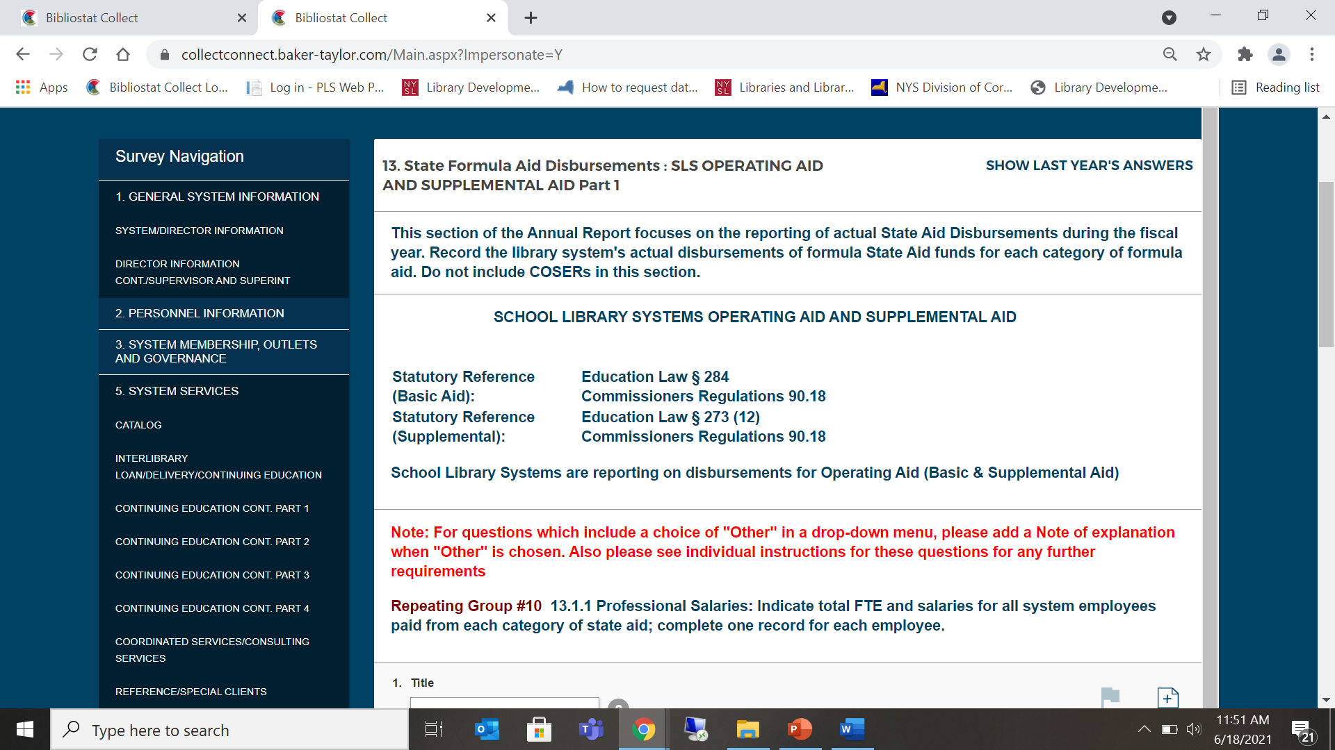
State Formula Aid Disbursements

Slide 33
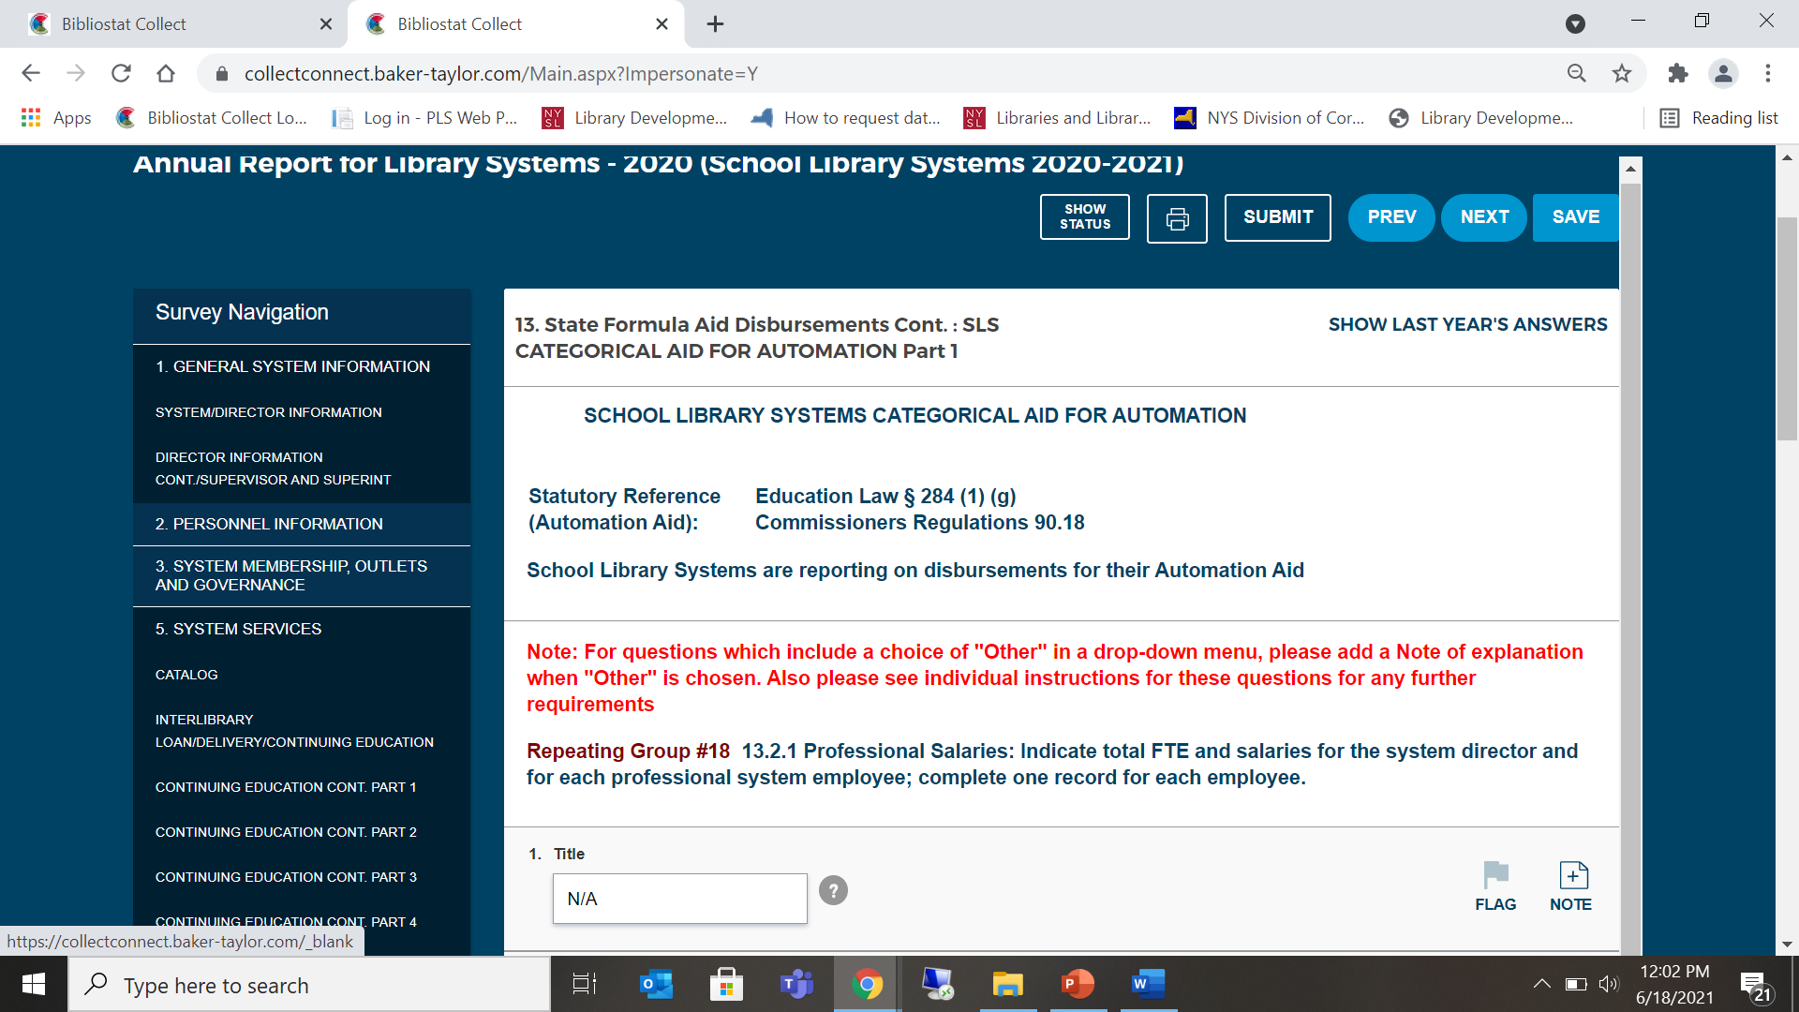
Categorical Aid for Automation

Slide 34
School Library System Fiscal Guidelines
The Fiscal Guidelines for School Library Systems provide general guidance for the financial management of State Aid by local agencies. In addition to these guidelines, School Library System (SLS) programs must be conducted in accordance with applicable State laws, regulations, and directives; including but not limited to:
Commissioner’s Regulation §90.18
State Education Law §282, §283, §284; §273(12)
Local Finance Law
State Education Department Policy
https://www.nysl.nysed.gov/libdev/slssap/fiscal.htm

Slide 35
Questions?
Contact
Mary Beth Farr MaryBeth.Farr@nysed.gov
Jane Minotti Jane.Minotti@nysed.gov
For technical issues, Jeffrey.Kirkendall@nysed.gov

