Slide 1
REALM Project
Notes:
REopening Archives, Libraries, and Museums (REALM) is a research partnership between OCLC, the Institute of Museum and Library Services, and Battelle. Its aim is to conduct research on how long the COVID-19 virus survives on materials that are prevalent in libraries and museums, and how materials can be handled to mitigate exposure to staff and visitors.
Visit this website for more information on the project, research timeline, and committee members. Project updates and resources will be added to this information hub as they become available.
We encourage you to sign up to receive project updates by email and/or bookmark the project page, as it will be the primary source for sharing all program results and resources. You can also follow OCLC on Facebook, Twitter, LinkedIn for the latest project updates and join the conversation using #REALMproject.

Slide 2
Sharon Streams
REALM Project Director, OCLC
Director, WebJunction

Slide 3
IMLS
Project funder
Consult on project goals and activities
Coordinate formation of project steering committee and working groups
The Institute of Museum and Library Services is the primary source of federal support for the nation's libraries and museums. We advance, support, and empower America’s museums, libraries, and related organizations through grantmaking, research, and policy development. Our vision is a nation where museums and libraries work together to transform the lives of individuals and communities.
Notes:
Sharon

Slide 4
Working Groups
Executive Project Steering Committee
Comprised of leaders from across the archive, library, museum, and scientific fields that are meeting regularly to provide input to the REALM project.
Operations Working Group
Scientific Working Group
Communications Working Group
Bringing in the perspectives, needs and interpretations from across individual institutions, consortial systems, and member organizations.
Notes:
https://www.webjunction.org/explore-topics/COVID-19-research-project.html#committees

Slide 5
Battelle
Nonprofit contract research institute headquartered in Columbus, Ohio
Research and development across public health, consumer, industrial, medical, energy, national security
Division of biodefense & emerging infectious diseases including a biosafety Level (BSL)-3 laboratory
SARS-CoV-2 Critical Care Decontamination System

Slide 6
OCLC
Lead and manage execution of project deliverables
Coordinate Battelle scientific research
Collect, synthesize stakeholder input to inform decisions
Activate a cross-sector communication network
Publish and distribute research and information to the archives, libraries and museums communities

Slide 7
Phases
Notes:
Sharon
Everyone working on the project – from the staff at OCLC, to IMLS to Battelle and all of the members of the steering committee and working groups – we’re all eager and understand the urgency of getting the project findings out both quickly and responsibly. We know that archives, libraries and museum staff are very interested in this work and that the results are being used to inform local decisions.
The sense of urgency means we’re releasing results incrementally, when it may be too preliminary to draw conclusions.
We will be assembling shareable resources in a variety of formats that will apply our research to a library and museum context.
We look forward to learning from all types of organizations during their reopening to continue gaining real-world perspectives.
All of project results are announced through an email distribution list, which is open for anyone to sign up for.
https://www.oclc.org/content/oclc-forms/en_us/realm-updates.html

Slide 8
Project activities
Literature reviews of published science
Ongoing engagement with representatives and subject matter experts from archives, libraries, and museums
Laboratory testing of materials
Synthesize the above inputs into toolkit resources
Share project information and toolkit resources

Slide 9
REALM Project research
Battelle is conducting laboratory studies of how long SARS-CoV-2 survives on materials commonly found in libraries, archives, and museums.
Test 1 results published on June 22
Test 2 results published on July 20
Test 3 results to be published next week.
Test 4 initiated on July 31; publish in early Sept.
Materials testing in sets of five items per test.
Phase 1 Systematic Literature Review of SARS-CoV-2 literature available as of May 2020; published on June 17, 2020.
Phase 2 literature review underway, to be published in September.

Slide 10
Literature review

Slide 11
Phase 1 literature review questions
?
How might the virus spread through public library general operations? How long does the virus survive on material surfaces through environmental attenuation? (Virus dying naturally, without intervention.) How effective are various prevention and decontamination measures that are readily available to public libraries in the near term? (Cleaning agents, PPE, shields, etc.)
?
?

Slide 12
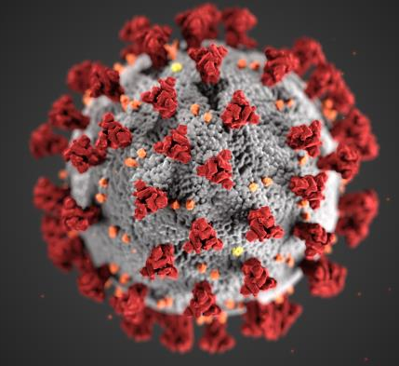
State of COVID-19 research
Because SARS-CoV-2 is emerging, knowledge about it is a work in progress; scientists are actively working to study and understand the virus.
The human infectious dose is still unknown. Studies of other viruses (e.g. SARS-CoV, MERS, influenza) have shown a wide range.
More empirical studies and peer-reviewed publications are needed to verify, expand, correct, and refute results from early work and fill in gaps in the research.
First literature review was completed in May.
A second review is underway now.

Slide 13
Literature Review Process
Search term development
Relevancy review of search results
QC of relevancy reviews
Abstracting and summarizing relevant articles
Writing the first draft
Revising/finalize draft

Slide 14
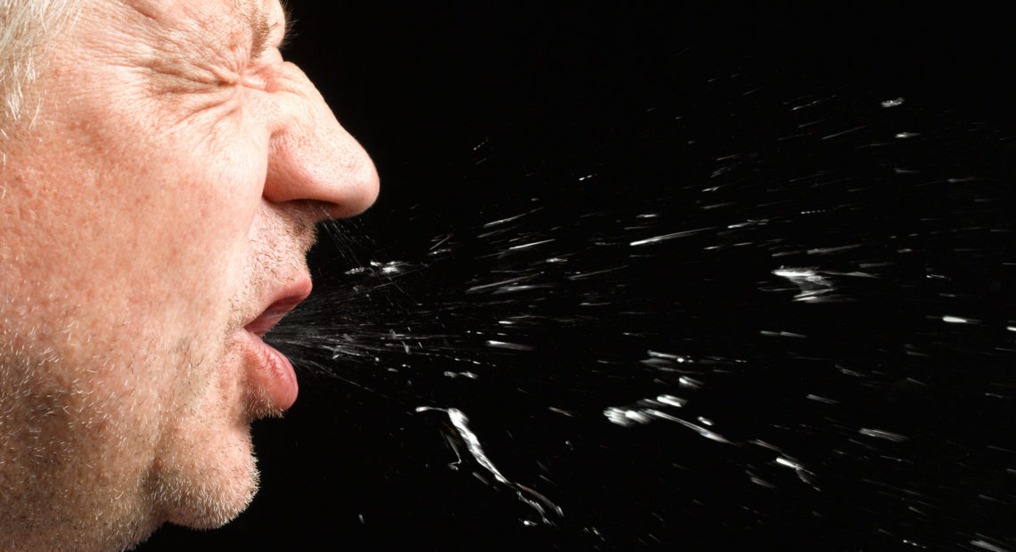
How the virus spreads
From the review of published scientific literature:
SARS-CoV-2 is generally thought to spread via
Direct transmission: virus-containing water droplets expelled from infected persons
Indirect transmission: objects, or fomites, can harbor the virus for an extended period of time after being contaminated by an infected individual
Other areas that require more exploration are aerosol particle transmission and human matter (in solid and aerosol)
Environmental factors such as humidity, temperature, ventilation/air flow, and air conditioning may also affect the spread of SARS-CoV-2
Notes:
Speaking, sneezing, coughing person to person
Asymptomatic aspect is what makes this especially challenging
A microscopic virus-filled particle of breath or spittle, around 5 to 10 microns — about the size of a red blood cell — that comes out of the nose or mouth of an infected individual when they breathe, speak, cough or sneeze. Droplets generally fall to the ground within a few feet of the person who expels them.
A virus-packed particle, smaller than 5 microns, that’s also expelled from an infected person’s mouth when breathing, speaking, coughing or sneezing. Unlike a droplet, smaller aerosol particles can remain suspended in the air.

Slide 15
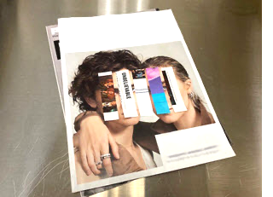
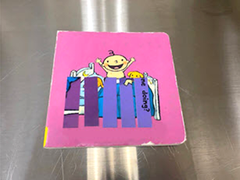
Survival of virus on surfaces
From the review of published scientific literature:
If SARS-CoV-2 is transferred to a physical surface, its survival time appears to vary based on material composition and roughness, before dying off on its own through natural attenuation.
A few early studies (not peer-reviewed) reported that the virus may survive longer on plastics and stainless steel than on paper products and other metals, such as copper.
However, it is not possible to draw firm conclusions from the results:
Small number of studies
Inconsistent experimental design
Notes:
Confounding factors, starting concentration, delivery medium, varied definitions of what the researchers considered dead

Slide 16
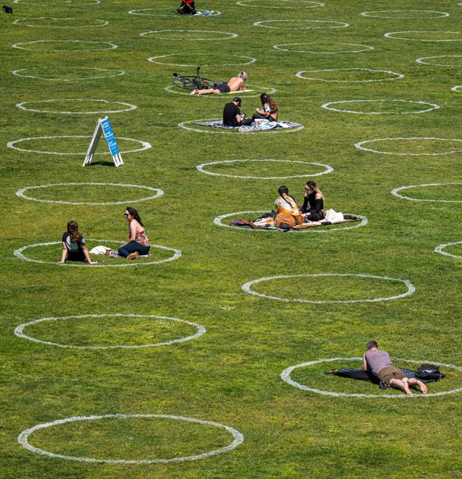
Prevention and decontamination
Researchers suggested several feasible, low-cost options for reducing the presence of SARS-CoV-2, which may help keep prevent spread:
Clean surfaces often
Practice social distancing
Wash hands frequently
Wear personal protective equipment (PPE)
Other factors that may impact survivability and help control spread may be ways that need more studies to find out if they work:
Heat treatment
Sunlight and other light-based treatments
Ventilation systems
Open spaces

Slide 17
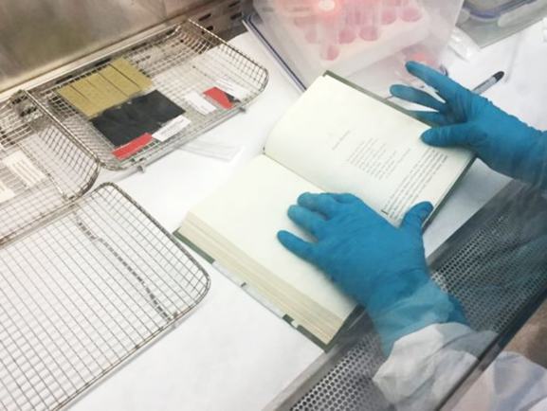
LAB TESTING

Slide 18
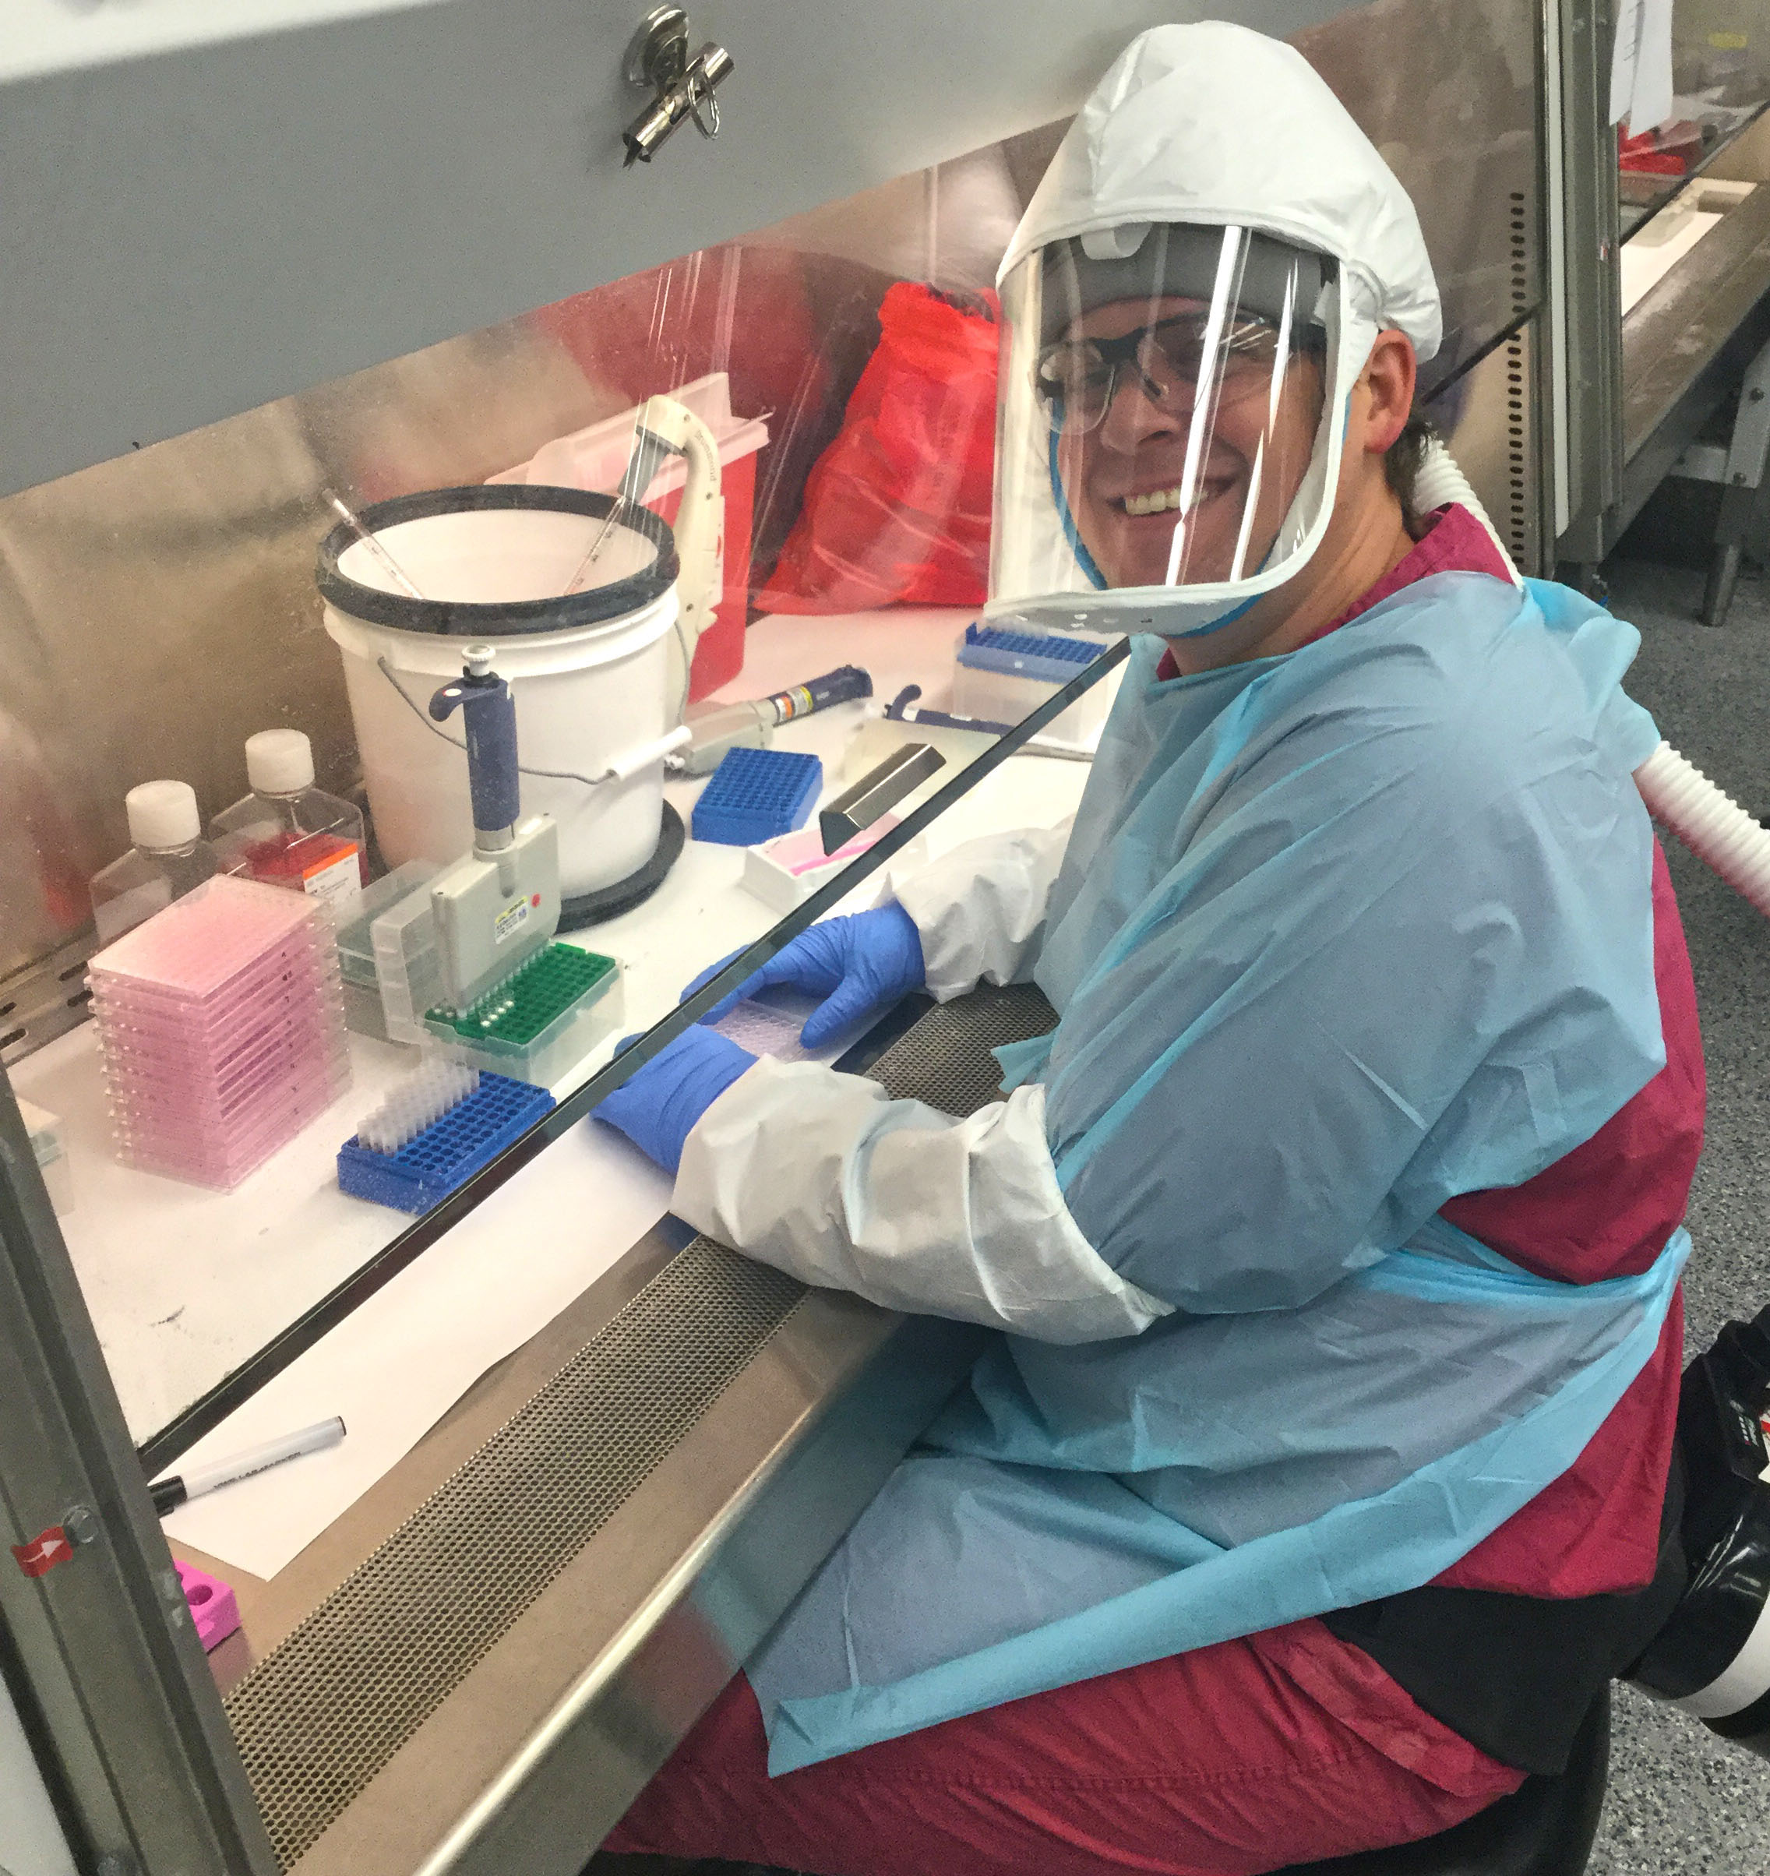
Testing overview
Objectives
Determine the effect of ambient environmental conditions on the SARS-CoV-2 virus when applied to common materials found in libraries, archives, and museums
Provide data to consider for selecting potential quarantine durations before materials can return to public circulation
Experimental design
5 test rounds, 5 material types per round
Droplets of live virus applied to material surface via ‘fake spit’
Materials stored in stacked or unstacked configurations
Measure quantity of viable virus at selected time points to capture the attenuation (drop) in total virus

Slide 19
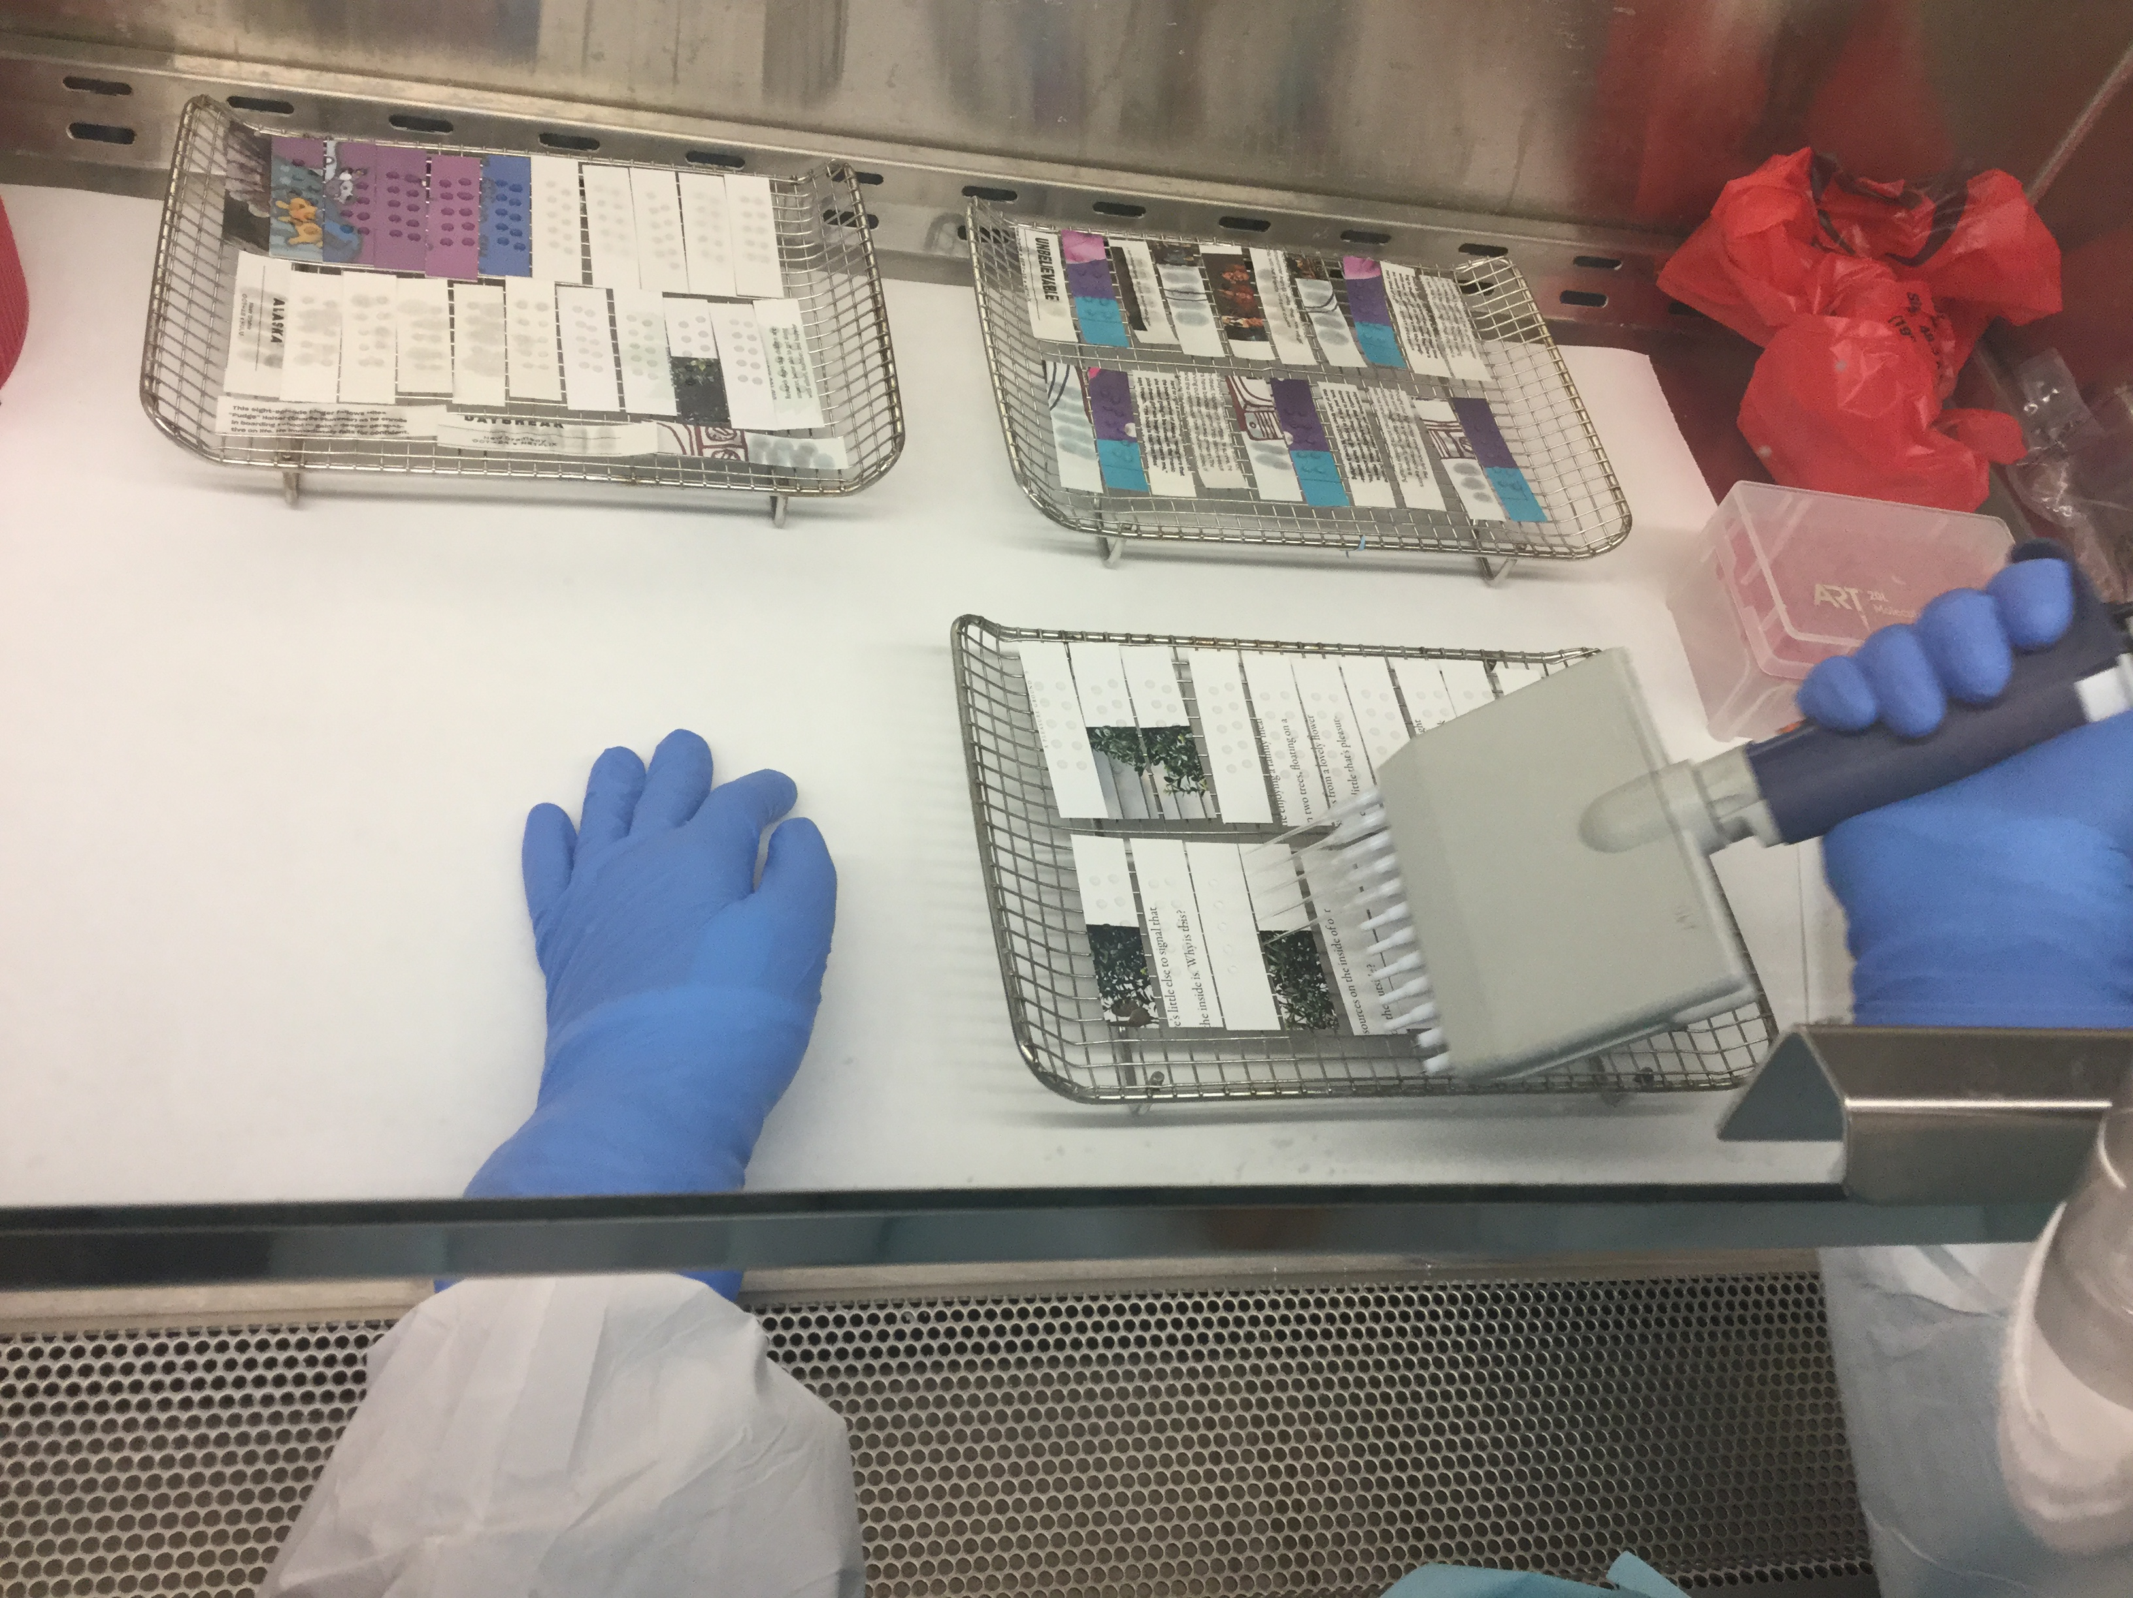
Testing walkthrough
Material prep:
Cut each material type into rectangular coupons
Material inoculation:
Apply droplets of virus stock solution with a known starting concentration of virus
Environmental testing and analysis:
At each timepoint, remove a set of coupons and process to measure the quantity of virus
Measured on a Log scale (e.g., 5 Log = 100,000 virus particles).
Limit of quantitation (LOQ):
The point at which researchers can only determine the presence or absence of virus by looking under a microscope: for this study, LOQ is 13.1 particles (1.31 Log)
Limit of detection (LOD):
Absence of virus in material sample or complete attenuation (cannot find it thru a microscope).

Slide 20
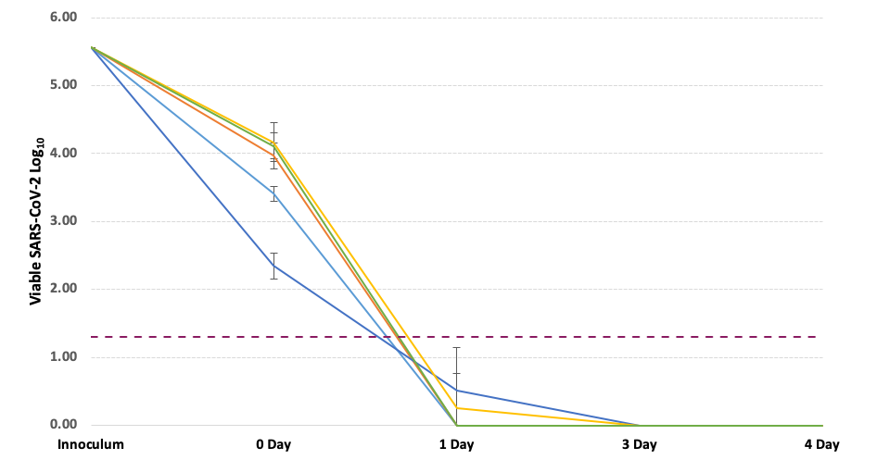
Test 1 SARS-CoV-2 natural attenuation (unstacked)
(*stacked)

Slide 21
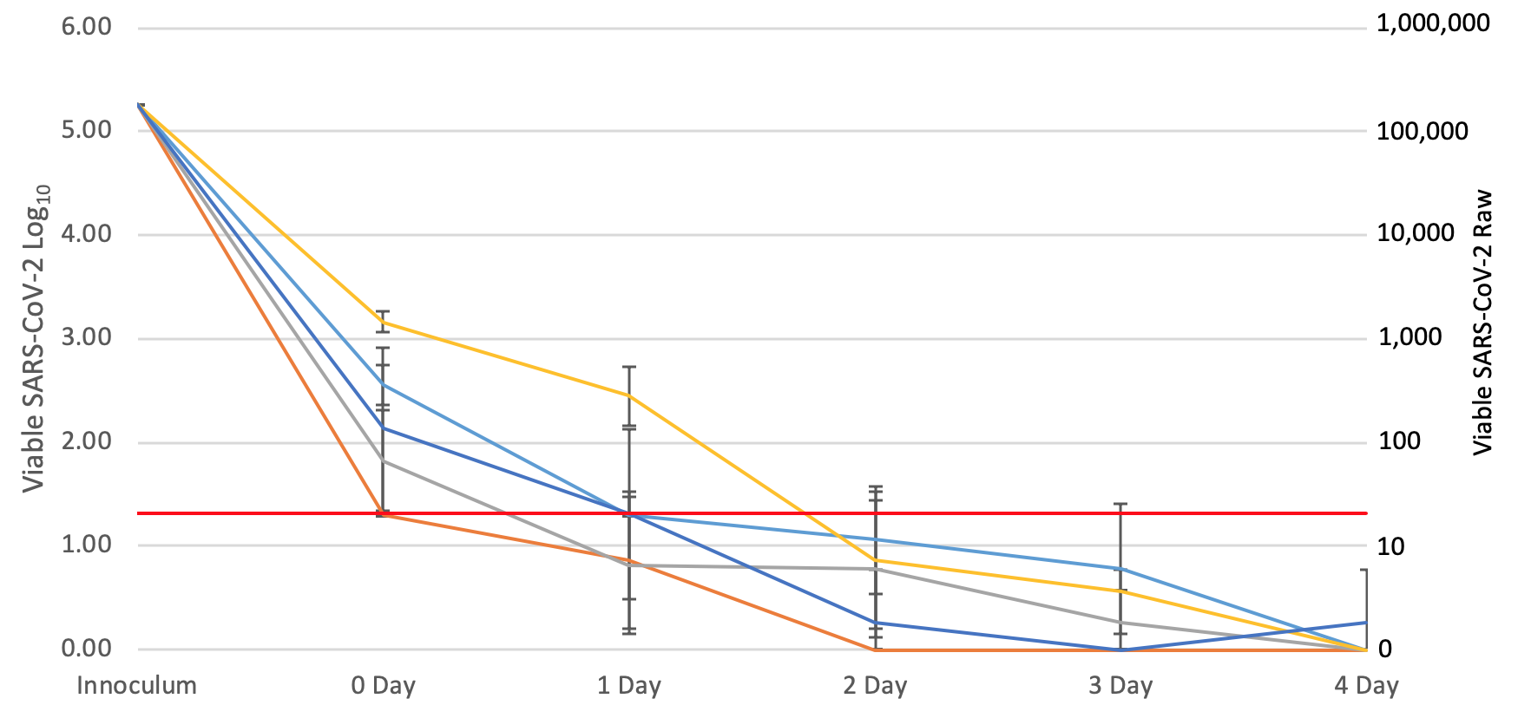
Test 2 SARS-CoV-2 natural attenuation (stacked)

Slide 22
Test 1 and Test 2 results (10 items)
Test # | ITEM | ATTENUATION DAYS | CONFIGURATION
1 | Hardback book cover | 1 | Not stacked
1 | Softback book cover | 1 | Not stacked
1 | Plain paper pages | 3 | Inside closed book
1 | Plastic book covering | 3 | Not stacked
1 | DVD case | 1 | Not stacked
2 | Braille paper pages | 4 | Stacked
2 | Glossy pages in coffee table book | 4 | Stacked
2 | Children’s board book (inside) | 4 | Stacked
2 | Magazine pages | 4* | Stacked
2 | Archival folders | 2 | Stacked
* The magazine pages showed a trace amount of virus at four days. Day four was the final timepoint tested.

Slide 23
Test 4, stacked materials
Hardcover books, stacked
Trade paperback books, stacked
Plastic protective covering, stacked
DVD cases, stacked
Expanded polyethylene foam
Testing began July 31
Timepoint days 0-2-3-4-6
Est. publish ~ Sept. 9

Slide 24
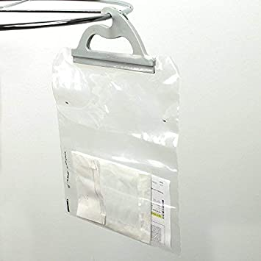
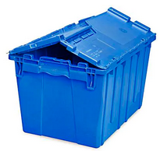
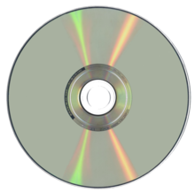
Test 3 on plastic materials
Talking book cassettes (ABS)
DVD (polycarbonate)
Acrylic sheet (Plexiglass)
Low-density polyethylene (LDPE) bag
High-density polyethylene (HDPE) container
Results next week!

Slide 25
SHARING THE RESEARCH

Slide 26
Discoverability, Open Access
Project work products are added to OCLC online archive as they are published
Regular crawls of REALM website
Literature reviews, data sets, reports, other documents
MARC record linked to Worldcat
Makes the work immediately discoverable to researchers through global database

Slide 27
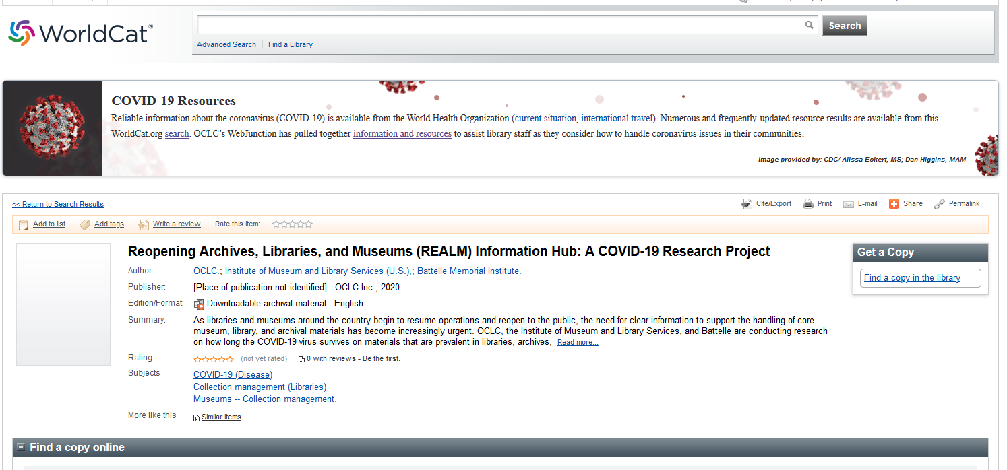
WorldCat Record
Notes:
https://oclclibrary.on.worldcat.org/search?databaseList=638%2C283&queryString=ti%3Drealm+project&clusterResults=true#/oclc/1158612099

Slide 28
Coming soon
More tests!
Phase 2 literature review complete in September
New project website
Toolkit resources
Illustrative examples from libraries, archives, and museums
Continued LAM community discussion
Notes:
In addition to these research activities, the project team will also be working to create and release additional resources to help inform your local decision making. We know that many of you are in conversations with your local and state health departments, as well as other aspects of government as you seek information on how COVID-19 can be addressed in the workplace. And we’ll be taking the results of the project testing, the literature reviews and the suggestions of the project steering committee and working groups to help us to create and release materials to help support your decisions.
Our priority is to share data and the scientific method in real-time, as results come in.
The sense of urgency means we’re releasing results incrementally, when it may be too preliminary to draw conclusions.
We will be assembling shareable resources in a variety of formats that will apply our research to a library and museum context.
We look forward to learning from all types of museums, archives and libraries during their reopening to continue gaining real-world perspectives.

Slide 29
Questions?

