Slide 1


Our Story Bridge:
Connecting the Past and the Present
Wednesday April 28, 2021, 1:30-3:00 PM
Presented by Jery Y. Huntley, MLS
with an introduction by Sharon B. Phillips,
Project Director for Ready to Read at New York Libraries

Slide 2
Welcome!
Today’s program is part of the
New York State Library’s Ready to Read
at New York Libraries initiative
For more info, please visit:
http://www.nysl.nysed.gov/libdev/earlylit/index.html
This webinar is supported in large part by the Library Services and Technology Act (LSTA) funds that were awarded to the New York State Library by the Institute of Museum and Library Services (IMLS).

Slide 3


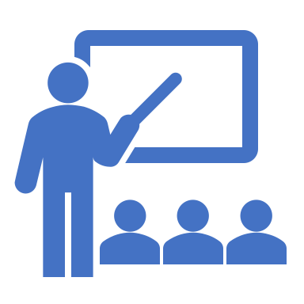

Housekeeping Reminders
Microphones will be muted for this webinar. Please ask questions via chat. Be sure to select “To: Everyone” when posting a question.
If the PowerPoint isn’t formatting correctly on your screen, select “Fit to Screen” under view options.
We will be asking you to complete a brief survey at the end of this program.
This webinar is being recorded and will be archived on the Ready to Read site.

Slide 4
Today’s Speaker
Jery Y. Huntley, MLS
www.ourstorybridge.org and www.myadirondackstory.org
Jery Y. Huntley received her MLS at the University at Albany, but her career took a different turn after her start as a school and public librarian on Long Island. She moved back to Albany to work for the NYS Assembly, then headed to Washington, DC for a position in the U.S. House of Representatives. This led to opportunities in environmental lobbying, issues management, twenty years as a trade association CEO, and training in meeting facilitation. She lives in Washington, DC and Keene Valley, NY, and her volunteer work now includes OurStoryBridge and Adirondack Community for the Keene Valley Library and as a member of the DC Medical Reserve Corps on COVID-19 test and vaccination sites.

Slide 5
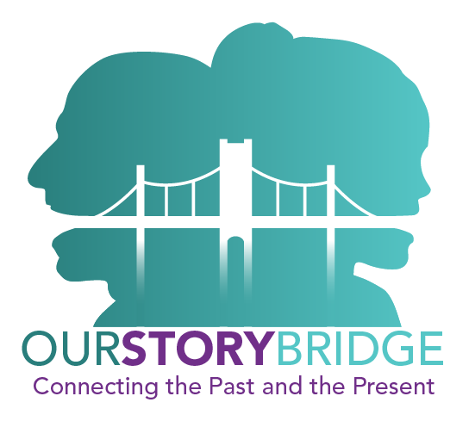
OurStoryBridge:
Connecting the Past and the Present
Jery Y. Huntley, MLS
Keene Valley Library
NYS Library
April 28, 2021
5

Slide 6
Presentation Objectives
Understand what’s on these websites and how you can use them
  Adirondack Community: Capturing, Retaining, and Communicating the Stories of Who We Are (www.myadirondackstory.org)
  OurStoryBridge: Connecting the Past and the Present (www.ourstorybridge.org)
Be inspired to explore the Teacher’s Guide contained on both websites so that you have a resource to use and share with students and teachers
Recognize how you can help communicate and improve the projects
Be Our Voice!

Slide 7
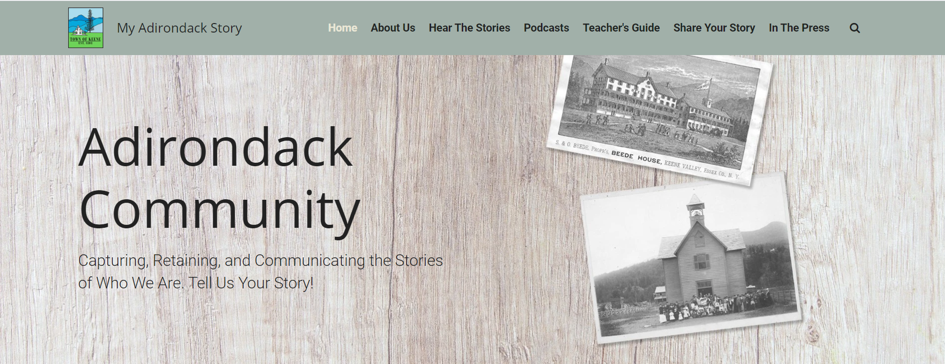
Go to www.myadirondackstory.org

Slide 8

About the Town of Keene
Marked on maps as uninhabitable before the late 1800s when America’s industrialists built their “Great Camps” and then railroads to provide access
Part of the six million-acre Adirondack Park declared “forever free” by the NYS Constitution in 1894
Year-round population struggles financially, usually with multiple jobs; 38% of students are labeled disadvantaged; similar problems as other poor, rural communities
Near Lake Placid, host of the 1932 and 1980 Winter Olympics; 46 “High Peaks” over 4,000’
Town population 1,100 with one central school of 160 students
Descendants of original summer folk still come, along with other summer residents
Educated and culturally rich community with a unique history
Two small libraries; Keene Valley Library hosts the story projects and “creates community”

Slide 9
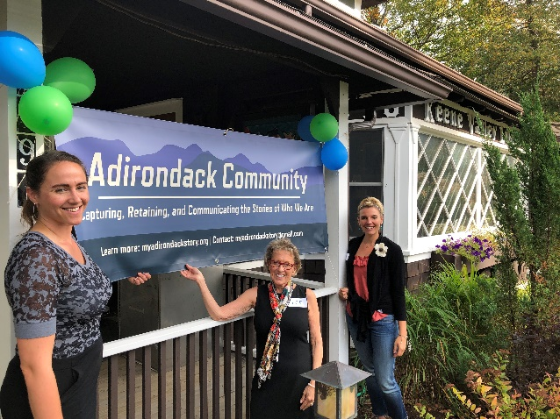
What is Adirondack Community?
Adirondack Community: Capturing, Retaining, and Communicating the Stories of Who We Are is a multi-year local history project that collects and organizes audio stories and related photographs from Town of Keene community members through an online platform to share the rich social and cultural history of this community located in New York State’s Adirondack Mountains.
A “story” is a first-person three- to five-minute unedited account by a “storyteller” in their own voice about their own experience and and/or those that came before them, accompanied by up to five photos usually from the library’s archives and posted on myadirondackstory.org in one - three of the eight categories selected by the community.

Slide 10
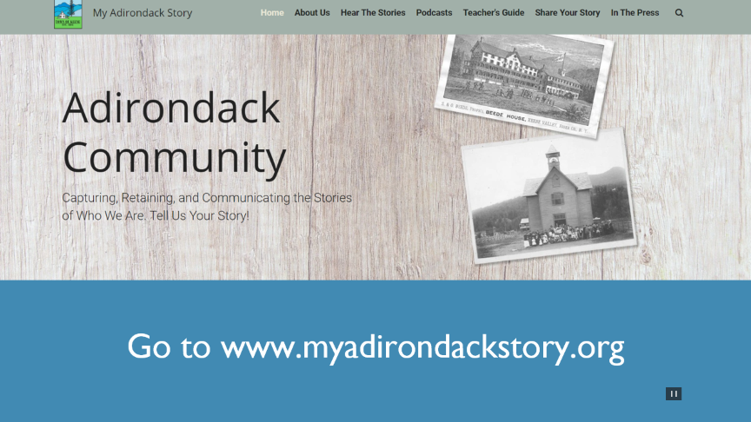
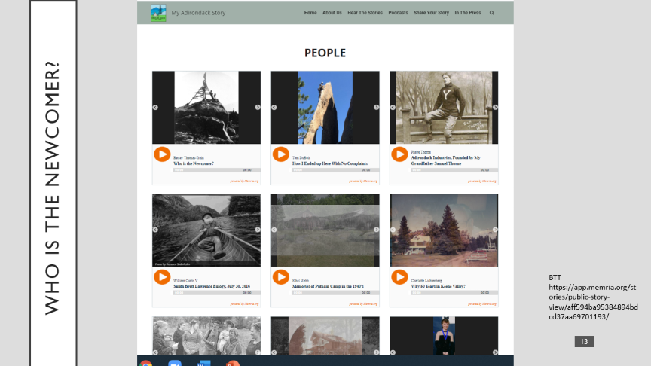

Review 1

Slide 11
Hear the stories
Go to www.myadirondackstory.org

Slide 12
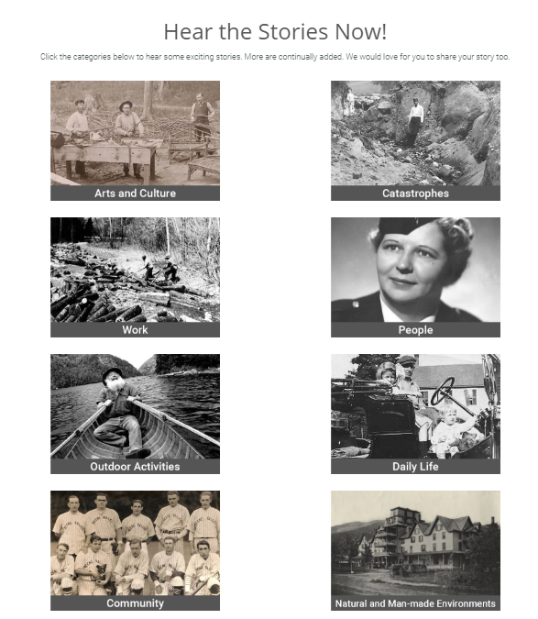
people
www.myadirondackstory.org

Slide 13
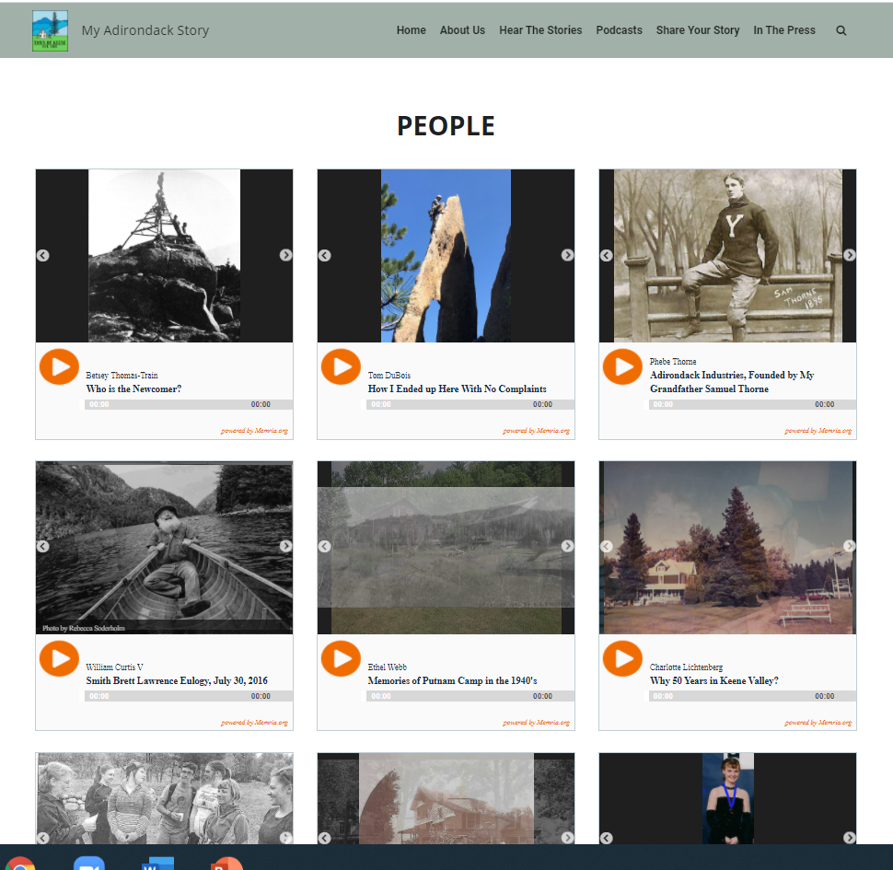
Who IS the Newcomer?
BTT https://app.memria.org/stories/public-story-view/aff594ba95384894bdcd37aa69701193/
https://app.memria.org/stories/public-story-view/14432f7403da462db04a499590dfc436/
www.myadirondackstory.org

Slide 14
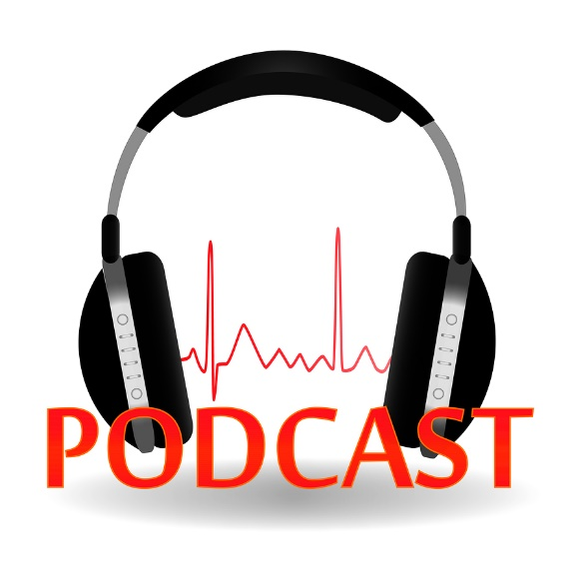
podcast
Social Justice & Social Change
Catastrophes & Community Reaction: Part I, Water
Catastrophes & Community Reaction: Part II, Fire & Mountains
Work, Part I
Famous People Here in the Town of Keene, Part I
Famous People Here in the Town of Keene Part II
Unique Outdoor Experiences
Legacy
Hiking Stories
This Photo by Unknown Author is licensed under CC BY-SA-NC

Slide 15






The Numbers Today
Chat: How many stories have we collected since June 2019?
4 2018 focus groups with 31 participants created the categories,
150 names of storytellers in initial worksheet,
3/4 stories collected pre-pandemic
>3,000 people have gone to the website,
388 follow the Facebook page,
>275 in storyteller worksheet
180+ stories in the eight categories, posted once, twice, or three times
Changed to more computers than mobile devices in the pandemic, maybe because more librarians are aware
At first, almost all came directly to myadirondackstory.org, but after beginning a Facebook page, boosting it regionally, and starting OurStoryBridge, new users grew from it
Most viewed categories are People, Outdoor Activities, and Catastrophes (inspired by the pandemic)

Slide 16

Marketing
Press Releases & Public Relations
Marketing Plan and Boilerplate
Posters & Banner
Business Cards
Posted on e-Newsletters and Listservs
Emails to Storytellers and Potential Storytellers
Community Events
Placement of Articles
Adirondack Community Story Project

Slide 17
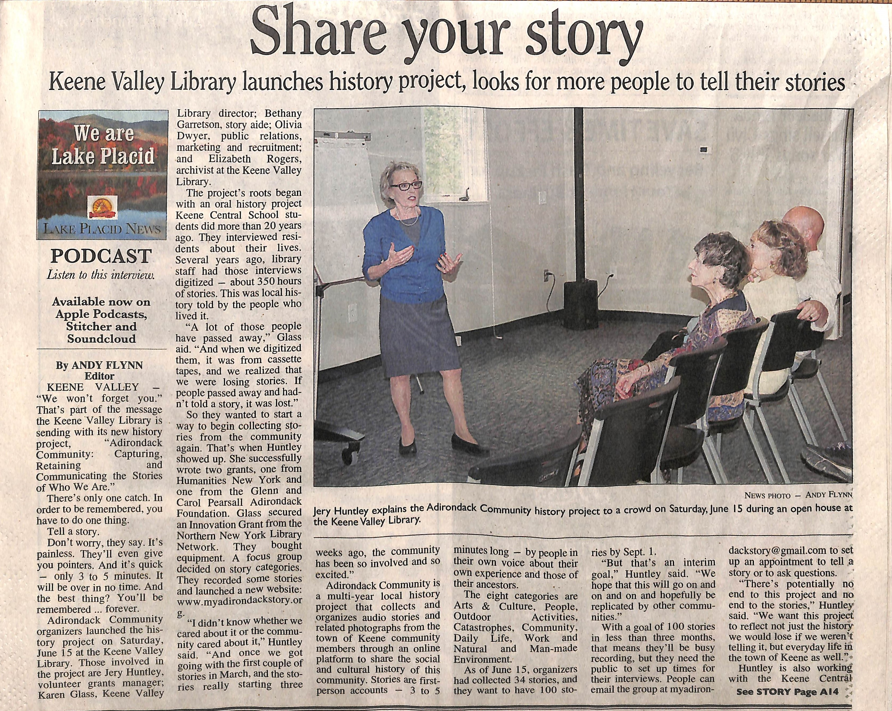
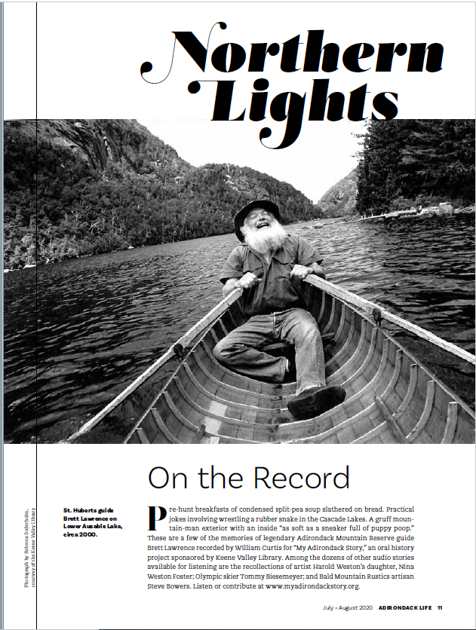
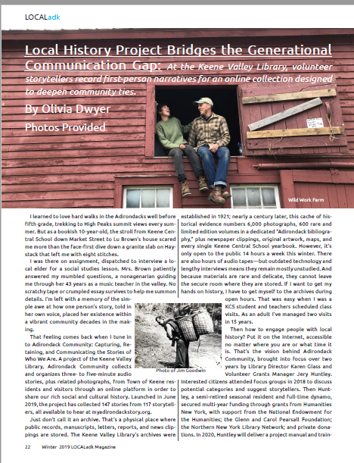
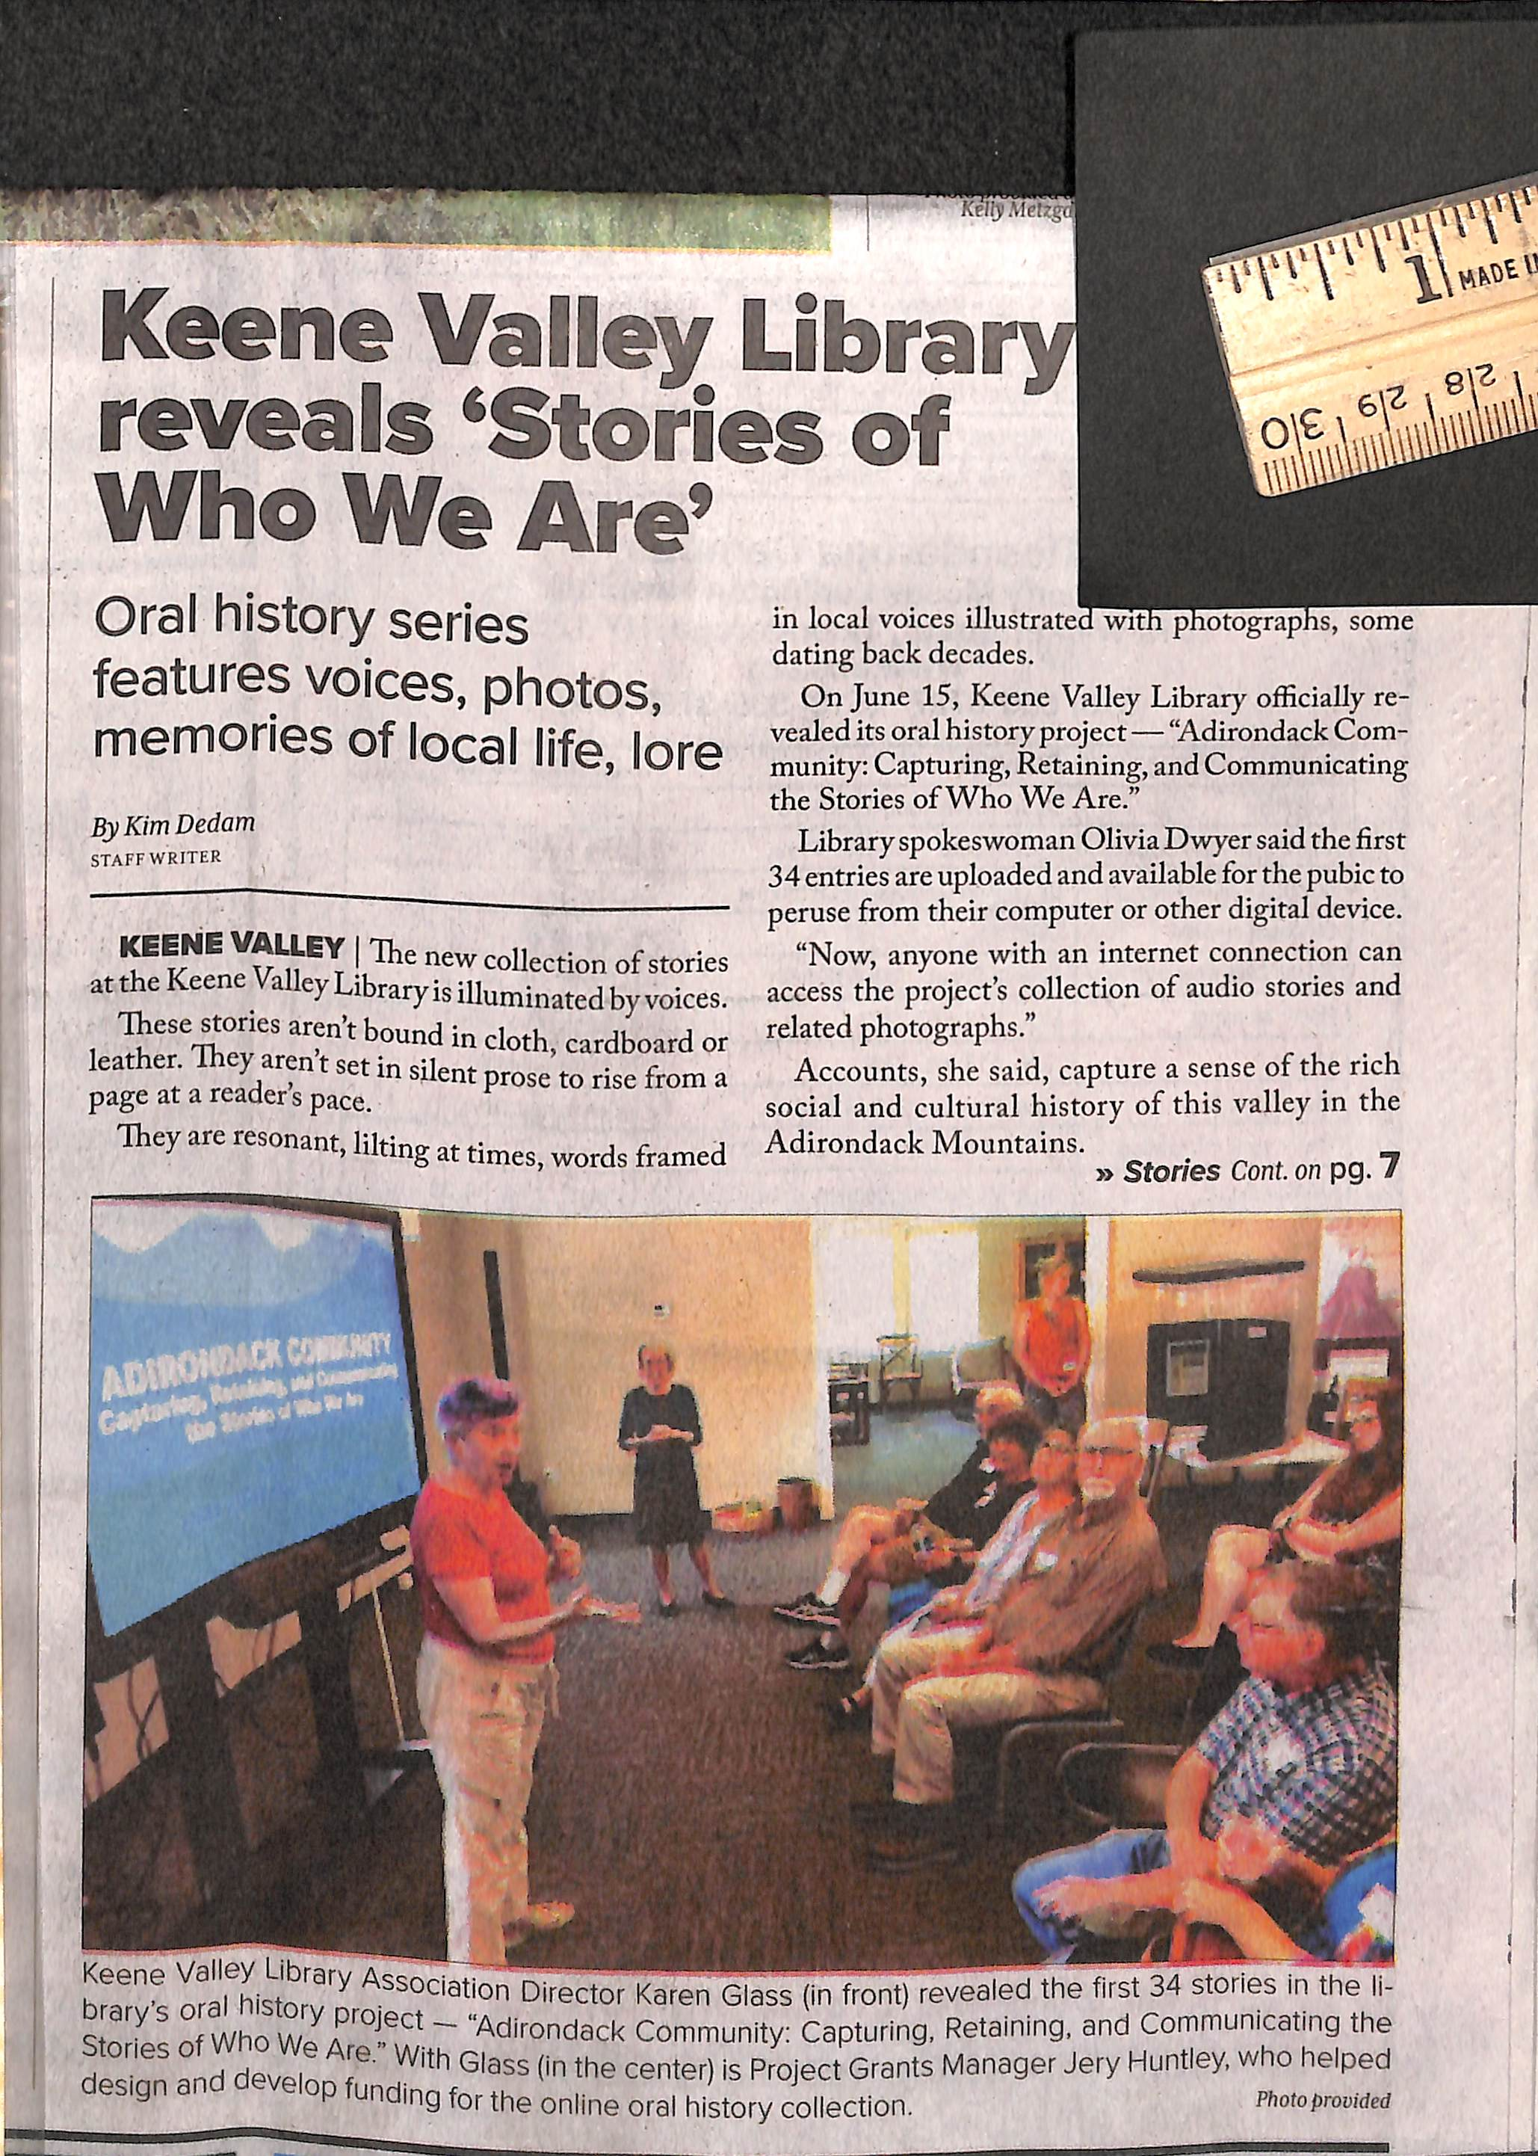
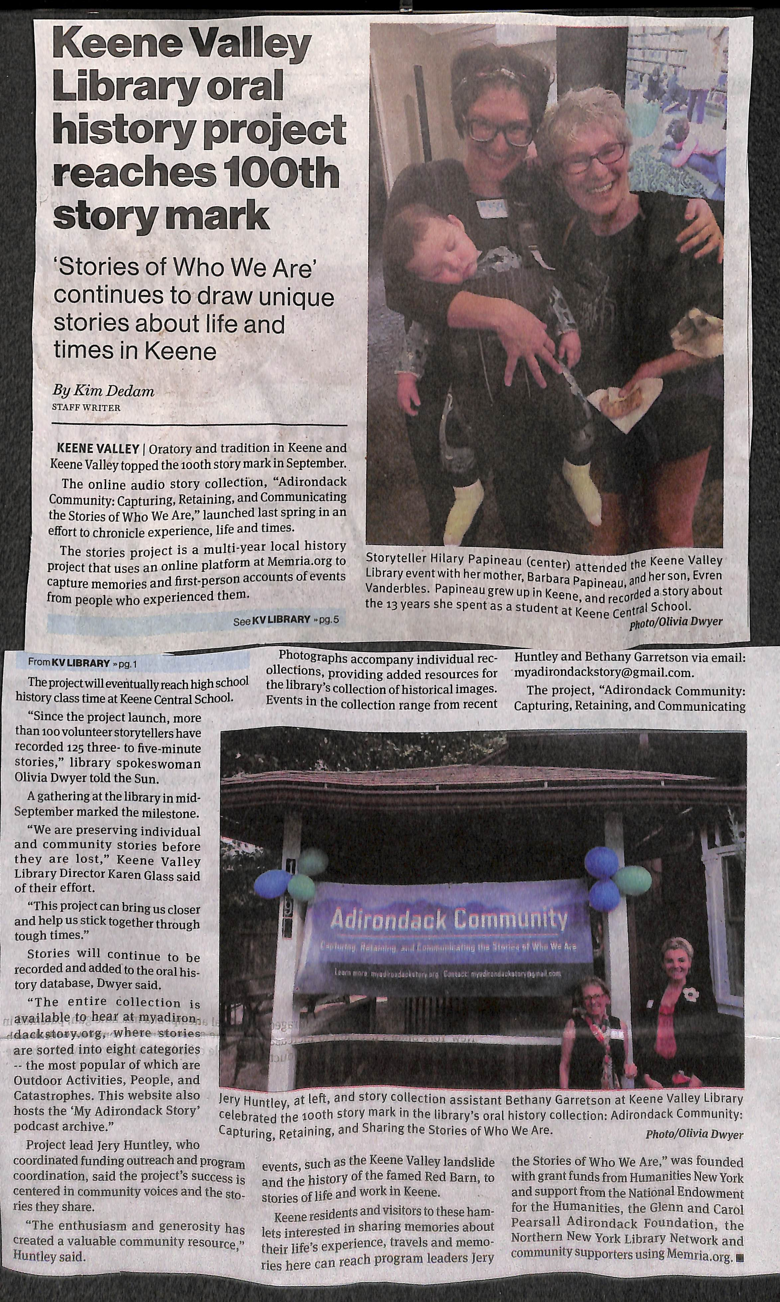
Newspaper clippings

Slide 18
What's exciting about
Adirondack Community?
Storytellers were hard to recruit at first; telling a story starts with nervousness, then leads to joy and more stories from the storytellers, then sharing that enthusiasm with neighbors so they tell their stories.
The whole town is talking (as is the media): school, family dinner tables, on the street, events, etc.
In the pandemic, listeners have increased greatly, hopefully finding comfort in the continued resilience of the community; we have also created a record of life during this crisis
Themes like social justice and social change, the community working together in crisis, aging here (especially women), the legacies that have been left, and the uniqueness of the area keep reappearing. Black Lives Matter stories, in a very White population, have been especially popular
It’s clear that the young and old don’t know who lives
here, have lived here, and have been here!

Slide 19

Measurement against goals
Goal #1: Capture stories before the storytellers are gone
  About 2/3 of storytellers are over 65
  The most elderly living here now and those who have come back to tell stories are involved, with plans for others we have identified
Goal #2: Get students involved and proud of their community, helping to prepare them whether they move away or come back
  Grades 9-12 have had school lessons on the project, check the website, and are genuinely surprised about what they are hearing, the first step!
  The pandemic has reduced ability to get stories from students, but the Teacher’s Guide is increasing classroom use and stories from students
Posted on a website that appeals to young and old!
This Photo by Unknown Author is licensed under CC BY-SA

Slide 20
Go to www.myadirondackstory.org to listen!

Slide 21
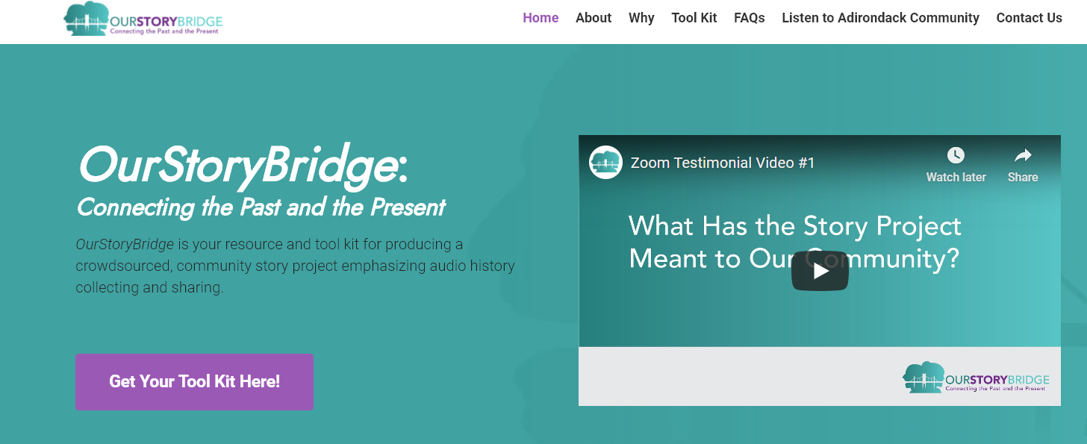
www.ourstorybridge.org

Slide 22
What Is OurStoryBridge?
Free resource and tool kit for producing a crowdsourced, community, online story project emphasizing audio history collecting and sharing
  Based on the Keene Valley Library’s Adirondack Community model, www.ourstorybridge.org, but adaptable for any community or topics
  With a commitment to help each community one-on-one!
  Especially during this pandemic, free online resources of interest to all generations take on unique importance

Slide 23

The $ Question…
Adirondack Community
OurStoryBridge
This Photo by Unknown Author is licensed under CC BY-SA-NC
Initially funded by grants
Community members stepped up to assure the future
Part-time jobs created in the community
Initially funded by seed grants (Cloudsplitter and Adirondack Foundations)
Currently seeking larger grants to hire staff
Costs of your OurStoryBridge projects are outlined in the User Guide
Leadership of both is supplied on a volunteer basis

Slide 24
The Tool Kit
1. User Guide
2. How-To Videos
3. Sample Documents
4. Teacher’s Guide (new)
Plus, free technical assistance as you begin!

Slide 25
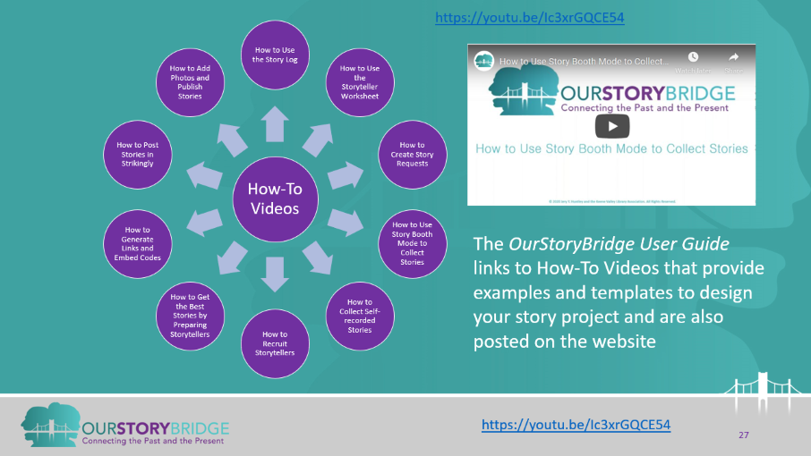
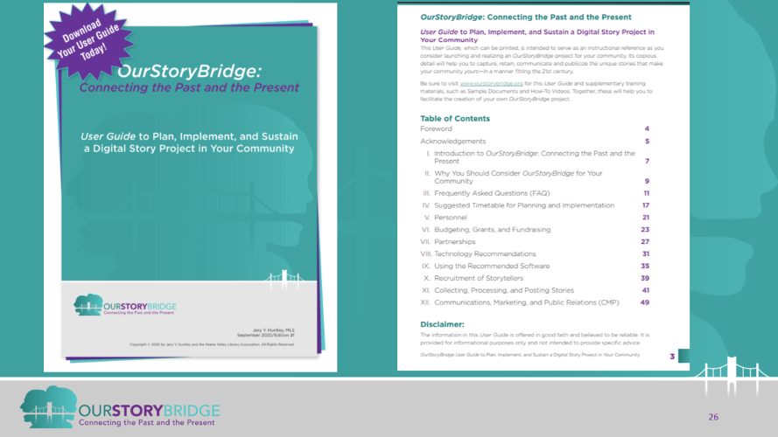
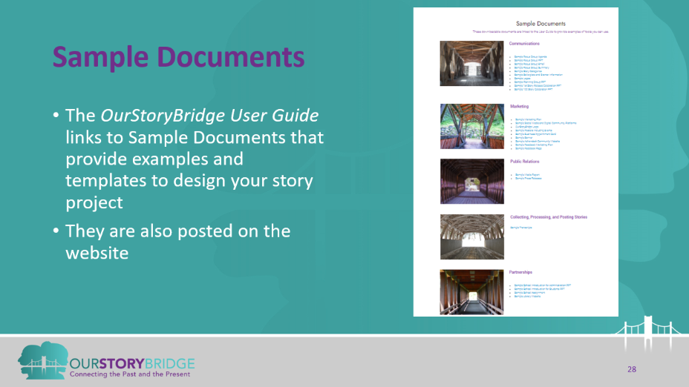
Review 2

Slide 26
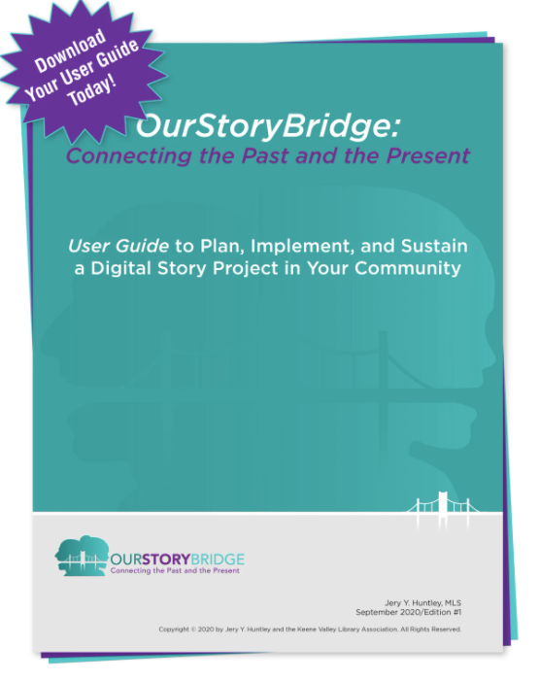
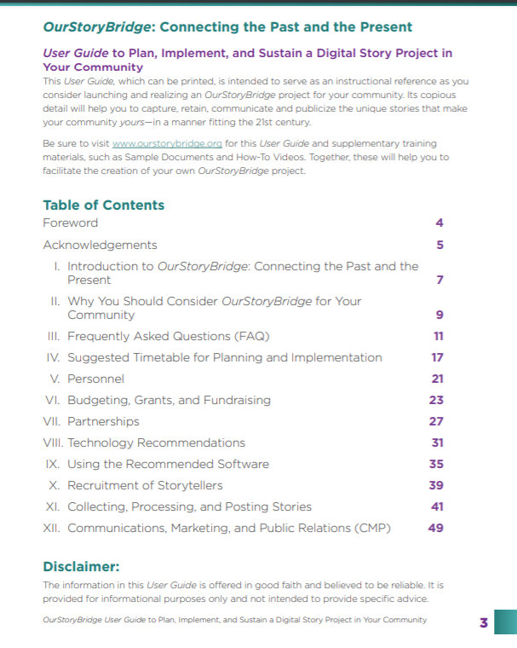
User Guide

Slide 27
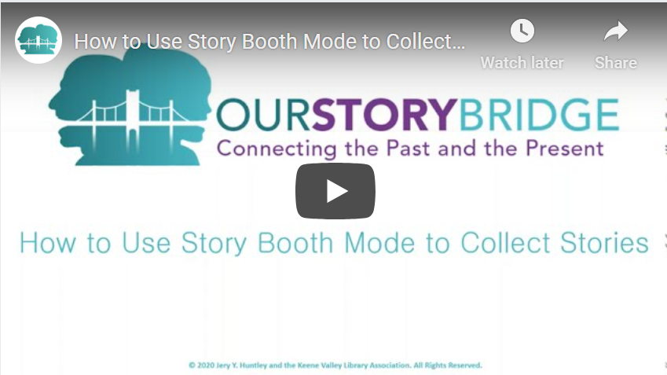
How-To Videos
https://youtu.be/Ic3xrGQCE54
How-To Videos
How to Use the Story Log
How to Create Story Requests
How to Use Story Booth Mode to Collect Stories
How to Collect Self-recorded Stories
How to Use the Storyteller Worksheet
How to Add Photos and Publish Stories
How to Post Stories in Strikingly
How to Generate Links and Embed Codes
How to Get the Best Stories by Preparing Storytellers
How to Recruit Storytellers
The OurStoryBridge User Guide links to How-To Videos that provide examples and templates to design your story project and are also posted on the website
https://youtu.be/Ic3xrGQCE54

Slide 28
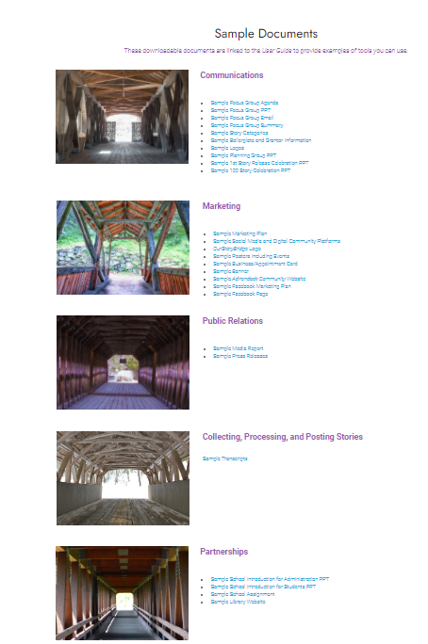
Sample Documents
The OurStoryBridge User Guide links to Sample Documents that provide examples and templates to design your story project
They are also posted on the website

Slide 29
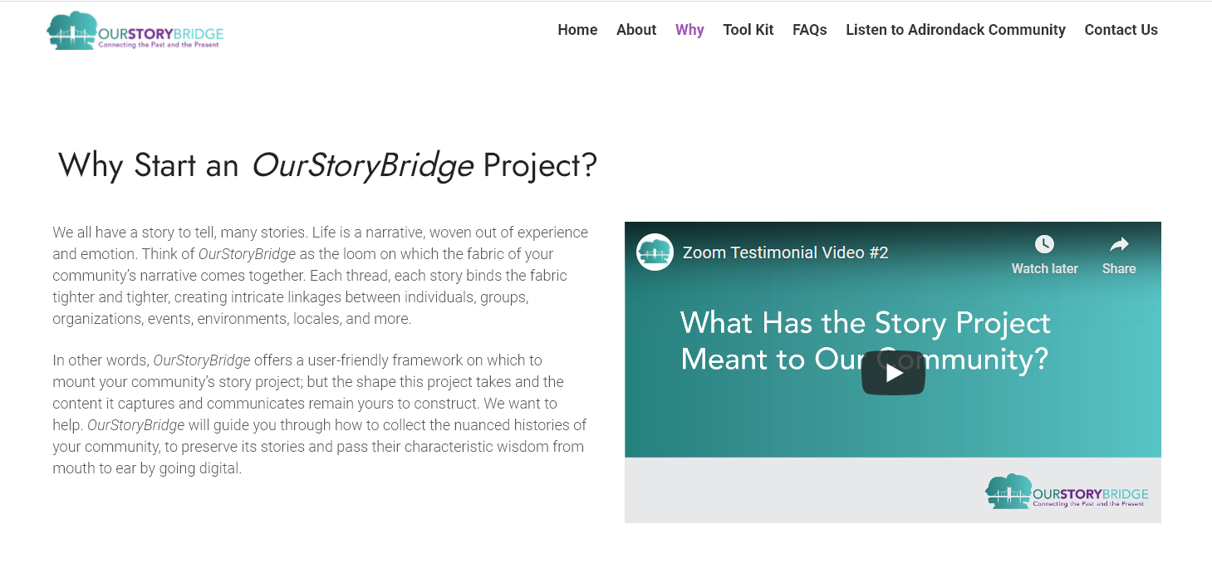
Why
https://www.youtube.com/watch?v=sMT-9MoWkeU#action=share

Slide 30
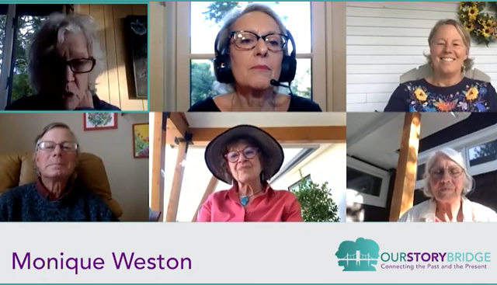
OurStoryBridge: Why?
Group Zoom with teacher https://youtu.be/Fqfvuu68E3E
“I love this project and think of it as a balm and a community builder for our times, an amazing educational resource, carrying rich historical value.”
— Janelle
Appreciate the history that shaped your community, that helps make it what it is today and what it can become tomorrow.
Create closer bonds between residents and promote connections that lead to neighborly acts of kindness, assistance and support in times of need.
Preserve stories that may be lost if not recorded soon and honor the legacies of your older generations by capturing their stories in their own words.
Engage the younger generations and encourage them to remain in or return to their home community after high school, college, trade school, or any number of life’s adventures.
Educate residents and visitors of all ages and inspire them to become contributing members of your community.
Celebrate what makes your community unique, perhaps even famous.
Large Group Zoom https://youtu.be/pOOyrBmnhdw

Slide 31
OurStoryBridge: Why? Pt. 2
Attract new residents and visitors.
Reveal pockets of rich histories and connections heretofore unknown or not widely known.
Acknowledge the catastrophes, tragedies, or difficult challenges that shape your community.
Appreciate how the geography and the economics of your area impact how your community members live.
Unravel the puzzle of how and why street or place names, stores, clubs, and other institutions came to be.
Re-ignite a passion for your community archives and/or previously recorded oral histories by translating some onto this new digital platform.
Meet your audience where they are: online!
“The story project keeps the history of our small town alive and accessible. The older residents of the town have recorded eyewitness accounts of important events that happened 60, 70 years ago, and memories of the people who were born in the 1800s. The younger ones have memorialized more recent ones, knowing themselves to be links in the chain of generations that bind this community together.” — Henrietta

Slide 32
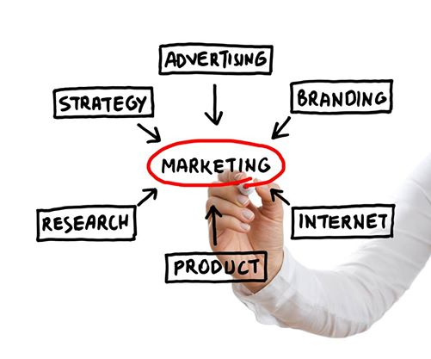
Marketing
This Photo by Unknown Author is licensed under CC BY-SA
Presentations to librarians and to teachers
OurStoryBridge Facebook page
Press releases
e-Newsletter
Networking
Logo use by new story projects
Blog posts and articles for e-newsletters

Slide 33
Teacher’s Guide
Brother Bud https://app.memria.org/stories/public-story-view/053c561c4a3e4cbe99db55baa72a1401/
Go to myadirondackstory.org

Slide 34
www.ourstorybridge.org

Slide 35
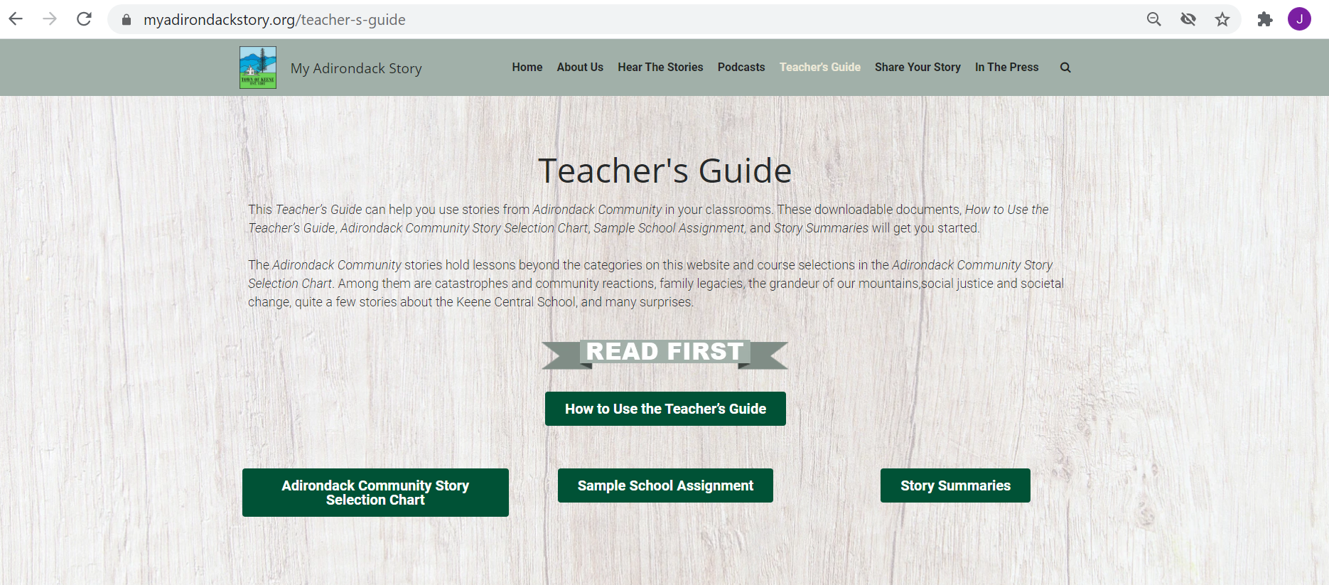




Teacher’s Guide Continued

Slide 36
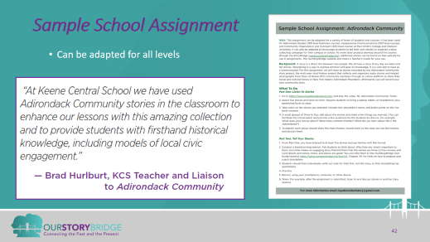
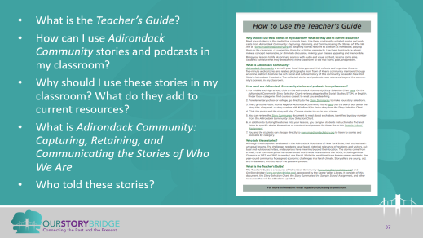
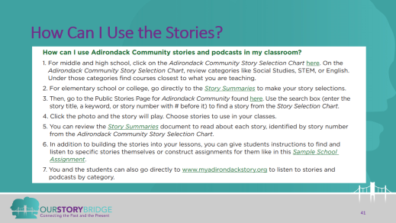
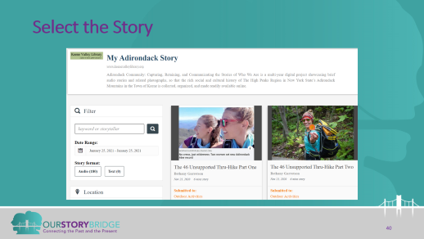
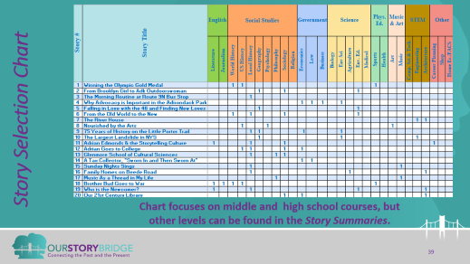
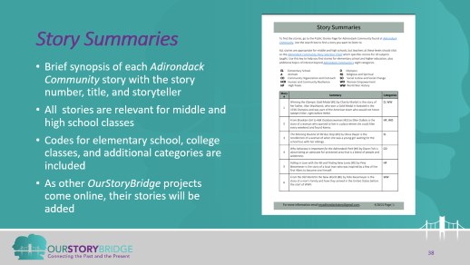
Teacher’s Guide

Slide 37
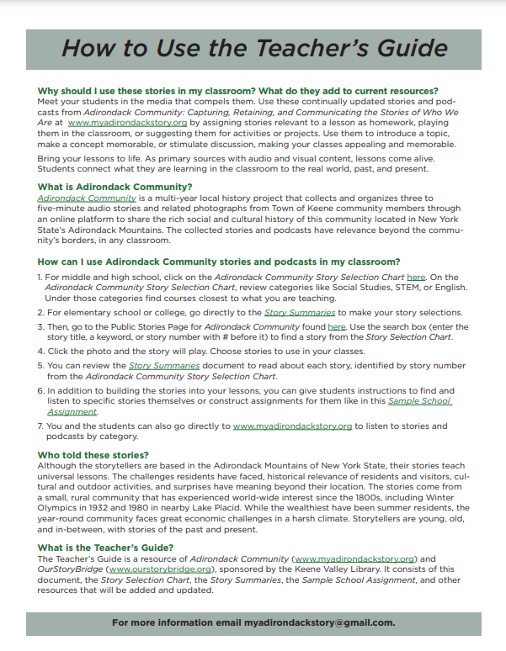
How to Use the Teacher’s Guide
What is the Teacher’s Guide?
How can I use Adirondack Community stories and podcasts in my classroom?
Why should I use these stories in my classroom? What do they add to current resources?
What is Adirondack Community: Capturing, Retaining, and Communicating the Stories of Who We Are
Who told these stories?

Slide 38
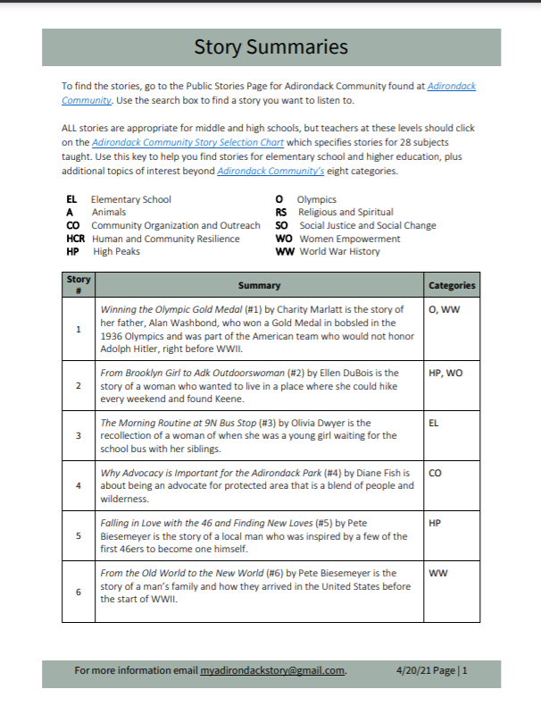
Story Summaries
Brief synopsis of each Adirondack Community story with the story number, title, and storyteller
All stories are relevant for middle and high school classes
Codes for elementary school, college classes, and additional categories are included
As other OurStoryBridge projects come online, their stories will be added

Slide 39
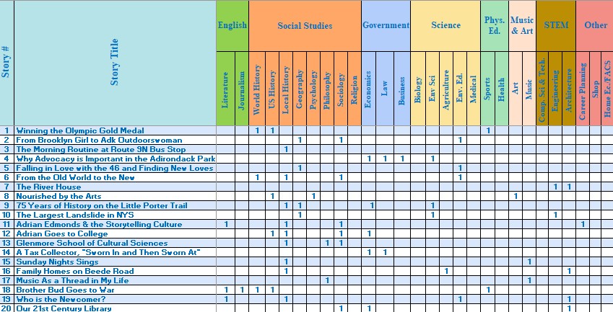
Story Selection Chart
Chart focuses on middle and high school courses, but other levels can be found in the Story Summaries.

Slide 40
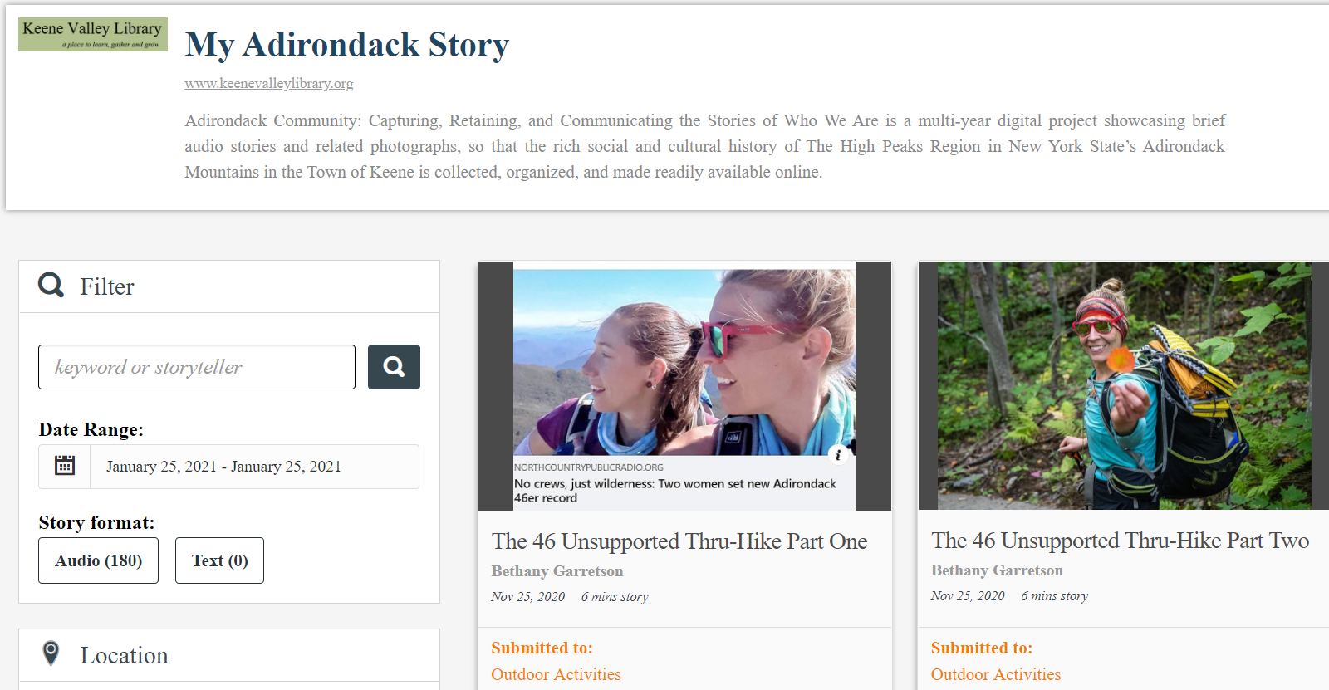
Select the Story

Slide 41
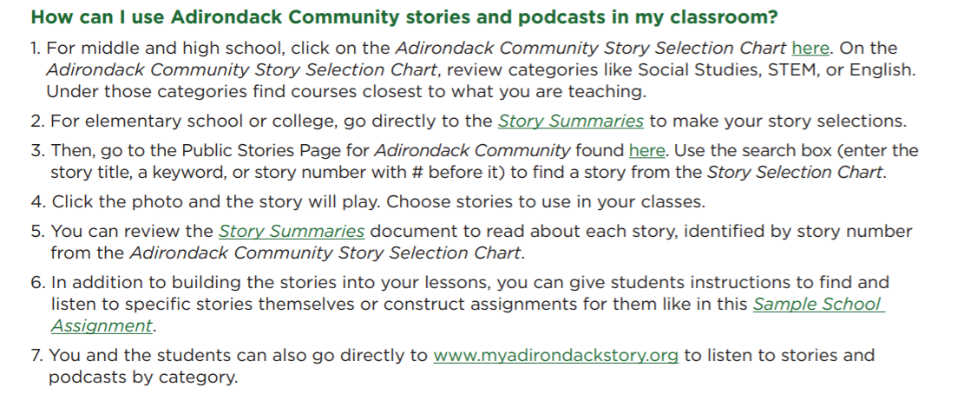
How Can I Use the Stories?

Slide 42
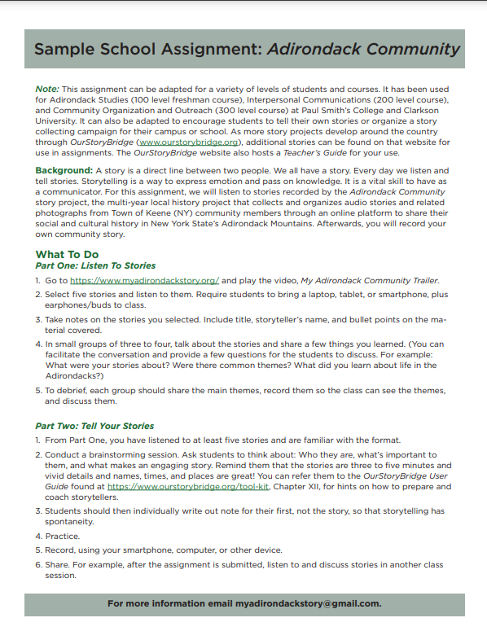
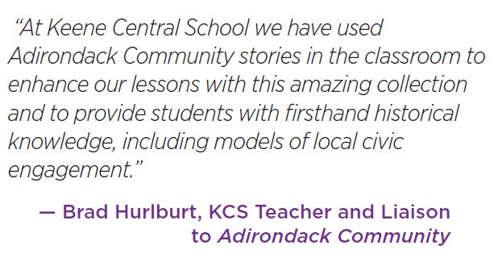
Sample School Assignment
  Can be adapted for all levels

Slide 43
Why Use the Stories?
Meet students in the media that compels them
Create closer bonds and community connections
Introduce a topic, demonstrate a concept, or stimulate discussion, making your classes appealing and memorable
Engage the younger generations with their community's rich history
Increase civic engagement of all community members
Celebrate what makes your community special
Reveal people, stories, and unique anecdotes not widely known
Use these continually updated stories and podcasts from www.myadirondackstory.org by assigning stories relevant to a lesson as homework, playing them in the classroom, or suggesting them for activities or projects
Tommy https://app.memria.org/stories/public-story-view/33d329b1cf074994a92be7ef5fa2bf0d/
Tommy https://app.memria.org/stories/public-story-view/33d329b1cf074994a92be7ef5fa2bf0d/

Slide 44
OurStoryBridge: What’s Next?
Presentations to librarians, teachers, museums, historical societies, and other organizations
  Create awareness of the free resources
  Generate interest in starting OurStoryBridge projects and using the stories with students
Creating a focused ten-year growth plan, starting with NY
Promoting and expanding the Teacher’s Guide
Creating partnerships to help us grow
Continuing the public relations and marketing program
Staying connected with an e-newsletter and Facebook pages
Free one-on-one assistance for interested communities
Generating funding for OurStoryBridge to help communities as they begin their story projects
Testing and improving the tools and resources

Slide 45




If You or Someone You Know is Interested in a Local Story Project…
Check out www.myadirondackstory.org www.ourstorybridge.org
Listen to a few stories found on either
Review the Tool Kit and other resources
Fill out the form on the OurStoryBridge website or email createyourstoryproject@gmail.com

Slide 46
Be Our Voice!
Guide others to OurStoryBridge if you think they are interested in starting a story project
Show patrons, especially students, Adirondack Community so they can hear the stories and podcasts
Introduce local teachers to the Adirondack Community stories to use in their classrooms, using the Teacher’s Guide
Put links on library/school library/BOCES resource pages
Volunteer to review the resources or help us grow OurStoryBridge
Follow and Like the Adirondack Community Story Project and OurStoryBridge Facebook pages
Send names and email addresses for the e-newsletter
Suggest grant and other funding sources
Tommy https://app.memria.org/stories/public-story-view/33d329b1cf074994a92be7ef5fa2bf0d/
How can you use the stories?
Will https://app.memria.org/stories/public-story-view/72f0dc8892ab4c1b996338d87a95b879/

Slide 47

Questions?
Contact us:
Jery Y. Huntley, MLS
createyourstoryproject@gmail.com
www.myadirondackstory.org www.ourstorybridge.org

Slide 48

Conclusion
Thank you for participating – any questions?
A survey will be emailed to you shortly – please take a few minutes to respond. We truly appreciate your feedback!
Contact information for speakers:
  Jery Y. Huntley: createyourstoryproject@gmail.com
  Sharon B. Phillips: Sharon.Phillips@nysed.gov

