Slide 1
A Guide to Applying for State Aid for Library Construction
March 16, 2020
Natalie McDonough
New York State Library
Division of Library Development

Slide 2
Outline
What is State Aid for Library Construction
What is and isn’t eligible / Priorities
Timeline
The application
Public Library System review
New York State Library (NYSL) review
Dormitory Authority of the State of New York (DASNY) review
Requirements of the program post-award
Progress and Final reporting

Slide 3
What Is Construction Aid?
Education Law 273-a
Funds from an appropriation of $NN million in capital funds in the State Budget to provide up to 75 percent of approved costs for broadband installation in, or construction, renovation, or rehabilitation of, or site acquisition for, public libraries and public library system headquarters
http://www.nysl.nysed.gov/libdev/construc/index.html

Slide 4
What’s New for 2020-2021?
In October 2019, two new laws amended Education Law 273-a
Chapter 381 of the Laws of 2019 allowing for funding of projects at up to 90% of the project cost, with the library providing a 10% match.
Chapter 389 of the Laws of 2019 allowing for coordinated applications for projects to be submitted by the public library system.
http://www.nysl.nysed.gov/libdev/2019leg.htm

Slide 5
Chapter 381 of the Laws of 2019– 90/10
“State aid may be provided for up to seventy-five percent of the total project approved costs for buildings of public libraries that are located in an economically disadvantaged community and that state aid may be provided for up to ninety percent of the total project approved costs for buildings of public libraries that are located in an economically distressed community.”

Slide 6
Chapter 389 of the Laws of 2019 – Coordinated Projects
Coordinated applications for state aid allocated under paragraph b of subdivision six of this section shall be submitted by the public library system.
The public library system shall be responsible for managing all coordinated projects. Each project shall be approved by the board of trustees of each participating library and the library system.
No one building shall be the subject of more than one coordinated project application per year

Slide 7
How is Construction Aid allocated?
“sixty percent of the funds … shall be made available … in such manner as to insure that the ratio of the amount received within each system to the whole of the aid … is no greater than the ratio of the population served by such system to the population of the state”
“forty percent of the funds … shall be made available … in such manner as to insure that an equal amount is received within each system in the state”
Ed. Law § 273-a

Slide 8
What is eligible?
New construction
Reconstruction, restoration, rehabilitation, remodeling, refurbishing
Broadband installation
Site acquisition (land with or without existing structure)
Equipment and furnishings, including computer equipment, within the context of an eligible construction project

Slide 9
What is eligible?
Electric generators
Permanent signage
Security systems
Assistive listening devices and systems
Supervision/management of the project(s)
Non-speculative architectural and engineering plans for approved projects

Slide 10
What is eligible? Priorities
Priority is given to projects that
increase energy conservation
provide accommodation for computer equipment and new technologies
bring libraries into compliance with the Americans with Disabilities Act
increase the safety and security of library staff and patrons
address service needs of communities which are geographically isolated and/or economically disadvantaged

Slide 11
What is not eligible? (not comprehensive)
Maintenance and repair activities, or what is perceived to fall into those categories.
New carpet, flooring, painting unless required by construction or code
Mold abatement as a stand-alone project
Equipment with a useful life of less than six years
Landscaping unless required by construction
Software licensing (only eligible as match funds)

Slide 12
What is not eligible? cont’d (not comprehensive)
Asbestos survey only
Per DASNY in 2019, asbestos abatement must be match funds.
Books, other library materials
Speculative architectural and engineering plans, building consultant feasibility studies

Slide 13
Program Cycle Year --Anticipated in FY2020-2021
Year 1- July 1, 2020-June 30, 2021
Application submission and review
Projects can begin work
Year 2- July 1, 2021-June 30, 2022
Awards are announced
Projects are underway
Progress Report if the project will not be completed by the end of the second year
Year 3 July 1, 2022-June 30, 2023 (if needed)
Project is completed
Final paperwork is submitted
Remaining 10% is paid to the library

Slide 14
Program Cycle Year 1 -- Anticipated to start in FY2020-2021 (July 1, 2020-June 30, 2023)
Online Portal Opens June
Applications
Submitted to System August-September
Reviewed by System September
Submitted to NYSL Early October
Reviewed NYSL October-January
Submitted to DASNY March
Reviewed by DASNY March-May
Awards announced Summer (in Year 2)
Awards disbursed Summer (in Year 2)

Slide 15
Program Cycle Years 2-3 – Anticipated starting in FY 2020-2021
180-day Notice January (Year 2)
Progress Report/
Request for extension Spring (Year 2)
Extensions granted May-June (Year 2)
Projects close Anytime
Projects must close June 30 (Year 3)

Slide 16
Facts about library applications
One application per building (except for Coordinated projects)
Each application must describe a unique project(s)
Broadband project by System does not preclude other projects by individual libraries
Minimum award is $2500; no maximum award limit

Slide 17
Facts about Coordinated projects applications
One application per building
Each application must describe a unique project(s)
Broadband project by System does not preclude other projects by individual libraries
Minimum award is $2500; no maximum award limit

Slide 18
Sections of the application
Application form
Additional funding sources
Project narratives
Budget
NYS Financial forms
(FS-10, Payee Information, SED W-9)

Slide 19
The Application Form
Review the pre-filled information and submit any updates!
Ex: Library director’s name is different that what is listed in SEDREF
Email to: ldconstruction@nysed.gov
SEDREF
https://portal.nysed.gov/pls/sedrefpublic/sed_inst_qry_vw$.startup
Two different people are required as contacts
If the building is leased or owned by a school district

Slide 20
The Application
If the project meets any of the State Historic Preservation Office (SHPO) requirements [6-8 weeks for SHPO response]
If the project is in a building or site owned by a school district [Building permit from New York State Education Department (NYSED) Office of Facilities Planning (OFP) can easily take from 6-9 months]
Certificate of occupancy- is it required locally?
Start date – Match funds vs State funds
End date – Cannot be before application is due to system

Slide 21
Project Narratives
Project Title
Project Abstract – This is listed on the NYSL website and in information sent to Legislators, be descriptive, but concise
Description of Project – Describe complete project (2 generators, 21 LED light fixtures)

Slide 22
Project Narratives, cont.
Impact of Project
increased effectiveness of library service due to increased and/or improved building space
more efficient utilization of the building
improved access to and use of building services by all library users, including those with physical disabilities
provision of library services to geographically isolated or economically disadvantaged communities
Timetable and the application timetable should match
Budget Narrative (be sure that it matches the bids and application total)

Slide 23
Additional Funds:
Bullet aid
Member items
NY Economic Development Program grant
Utility, solar company incentives
Other local, state (NYSERDA), or federal public funds,
Funds from municipal bonds
Private funds
Friends Groups or Library Foundations or
A combination of funds from these sources
SAM Funds (State and Municipal Facilities Program) CANNOT be used as match funds.

Slide 24
Projects funded, in whole or in part, through the issuance of tax-exempt bonds, bond anticipation notes, revenue anticipation notes, or other similar form of obligation
Additional Funds:
Must include:
the applicable authorizing resolutions adopted by the library or issuing party,
a detailed breakdown of the expected or actual sources and uses of bond proceeds,
a copy of the final official statement relating to the applicable issuance if available,
and a current cost estimate of the entire project including:
a detailed breakdown of all project costs regardless of whether or not they will be funded with award proceeds
which costs are related to award funds
the total dollar amount that is being bonded for the project
If BANS are issued, a letter is required asserting that at the time BANS are converted to Bonds, the Bond issued for the project will be in an amount not to exceed the total cost of the project minus the award.

Slide 25
NYSL Review Financial Information
Budget documents
Three sections in the online application purchased services, supplies & materials and equipment
Payee information
SED W-9
FS-10 (Three copies in blue ink, original signature)

Slide 26
Attachments to the application - required
Assurances (the new form with the SAM question)
Bids, quotes
Proof of available funds
Pre-project photos (showing all items)
SEAF long/short form and map of the library location
Smart Growth form
***Please utilize the forms linked in checklist***

Slide 27
Attachments to the application - other
SHPO determination, if applicable
NYSED OFP permit, if applicable
Certificate of 10 year minimum lease/legal agreement from the end of the project and project approval from building owner, if applicable
Architectural or engineering plans, concept drawings, if available
Municipal consent for site/building acquisition projects, if applicable

Slide 28
Library System Review
“rank the applications from its system area in order of its recommendations, giving particular attention to the service needs of any communities which are isolated, economically disadvantaged or located beyond the reasonable service capabilities of other libraries which are members of such library system”
Commissioner’s Regs. §90.12

Slide 29
Library System Review cont’d
Evaluation & Reduced Match Form
“How will this project assist the applicant to provide more effective service within the system's standards of organization and service?” Must answer with description
Does the library system deem the library eligible for a reduced match requirement below 50%?
Attach a copy of the criteria the system uses to determine eligibility for the reduced match

Slide 30
NYSL Review
Application
Narratives
Financial forms
Attachments
System Evaluation and Reduced Match Form

Slide 31
NYSL Review cont’d
Reasons to contact System after NYSL review
Questions about content
Incomplete applications
Additional information needed
Project is ineligible
Ensure budget adds up in all locations

Slide 32
DASNY Review
Elements of the NYSL review AND
Review each application for statutory and tax law compliance
Review funding to ensure all State-funded project activities are bondable-costs
May also have questions for the System/Library which are forwarded to the system by NYSL
Review projects to ensure all State Aid funded activities are bondable

Slide 33
Awards
50% payable after January 1
40% payable after April 1
Typically, libraries will receive their first payments of 90% in summer (of Year 2).
Remaining 10% payable upon project completion and submission to NYSL of an approvable FS-10-F, post-project photographs, a Certificate of Occupancy if applicable.

Slide 34
Other Requirements of Construction Aid:
180-Day Start Requirement
Progress Report and Additional (Third) Year Request
Amendment to the Scope of the Project
“No project activity changes shall be made during the program activity period without the approval of the State Library.”

Slide 35
Amendment to Scope
Required if any element of the original project is changing
Project came in under budget and additional funds must be spent on some other eligible activity. (for example LED lighting)
Bids came in higher than expected and the library cannot complete all elements of the project
Amendment form must include revised bid documents
Project timetable has changed and library cannot complete the approved project.
Approval from NYSL is required before work can begin

Slide 36
Final Report (Project Closing) -1
Submit final report to NYSL including budget-final expenses and post-project photos.
NYSL reviews the report
NYSL approves the report and requests FS-10F forms from the library.
Remaining 10% paid once approved FS-10Fs are approved and submitted for payment

Slide 37
Final Report (Project Closing) -2
Budget - Final Expenses (required)
Expenses must equal the exact amount of the award PLUS at least the required match funds.
Certificate of Occupancy (if applicable)
If the library anticipated requiring a CO initially but was not necessary, please upload a written explanation and upload to the portal
If the library is unable to obtain a Certificate of Occupancy and is only issued a Certificate of Compliance, a written explanation from the town/village (on their letterhead) should be uploaded to the portal.
FS-10-F Long Form (required)
(Only AFTER the Final Expenses have been submitted to LD and approved by LD)
FS-10-A Budget Amendment Form (if applicable)
(Only if there is an amendment to the approved project budget categories)

Slide 38
Final Report (Project Closing) -3
Post Project Photos (required)
Include photos of all elements of the project that were included in the original Narrative, unless changed in an Amendment to Scope (5 LED lights, 9 new tables)
If it will not be feasible at the end of the project, take photos during the project (for example, a new septic system or oil tank)
Ensure that photos show clear details of work completed
If possible, label photos for each project component and put it into a Word document rather than uploading individual attachments.

Slide 39
Contacts
If you have any further questions, please do not hesitate to contact us:
http://www.nysl.nysed.gov/libdev/construc/index.html
How to get an account for the online portal?
https://eservices.nysed.gov/ldgrants/ldgext/diRegistration.do
Questions about eligibility for 90/10 match?
Julia Maxwell Julia.A.Maxwell@nysed.gov
Could this project be eligible?
Systems Brooklyn-New York Public Library
Frank Rees francis.rees@nysed.gov
Systems Nioga-Westchester
Natalie McDonough natalie.mcdonough@nysed.gov
How do I close a project?
Lita Cromartie Collesides Estralita.Cromartie@nysed.gov

Slide 40
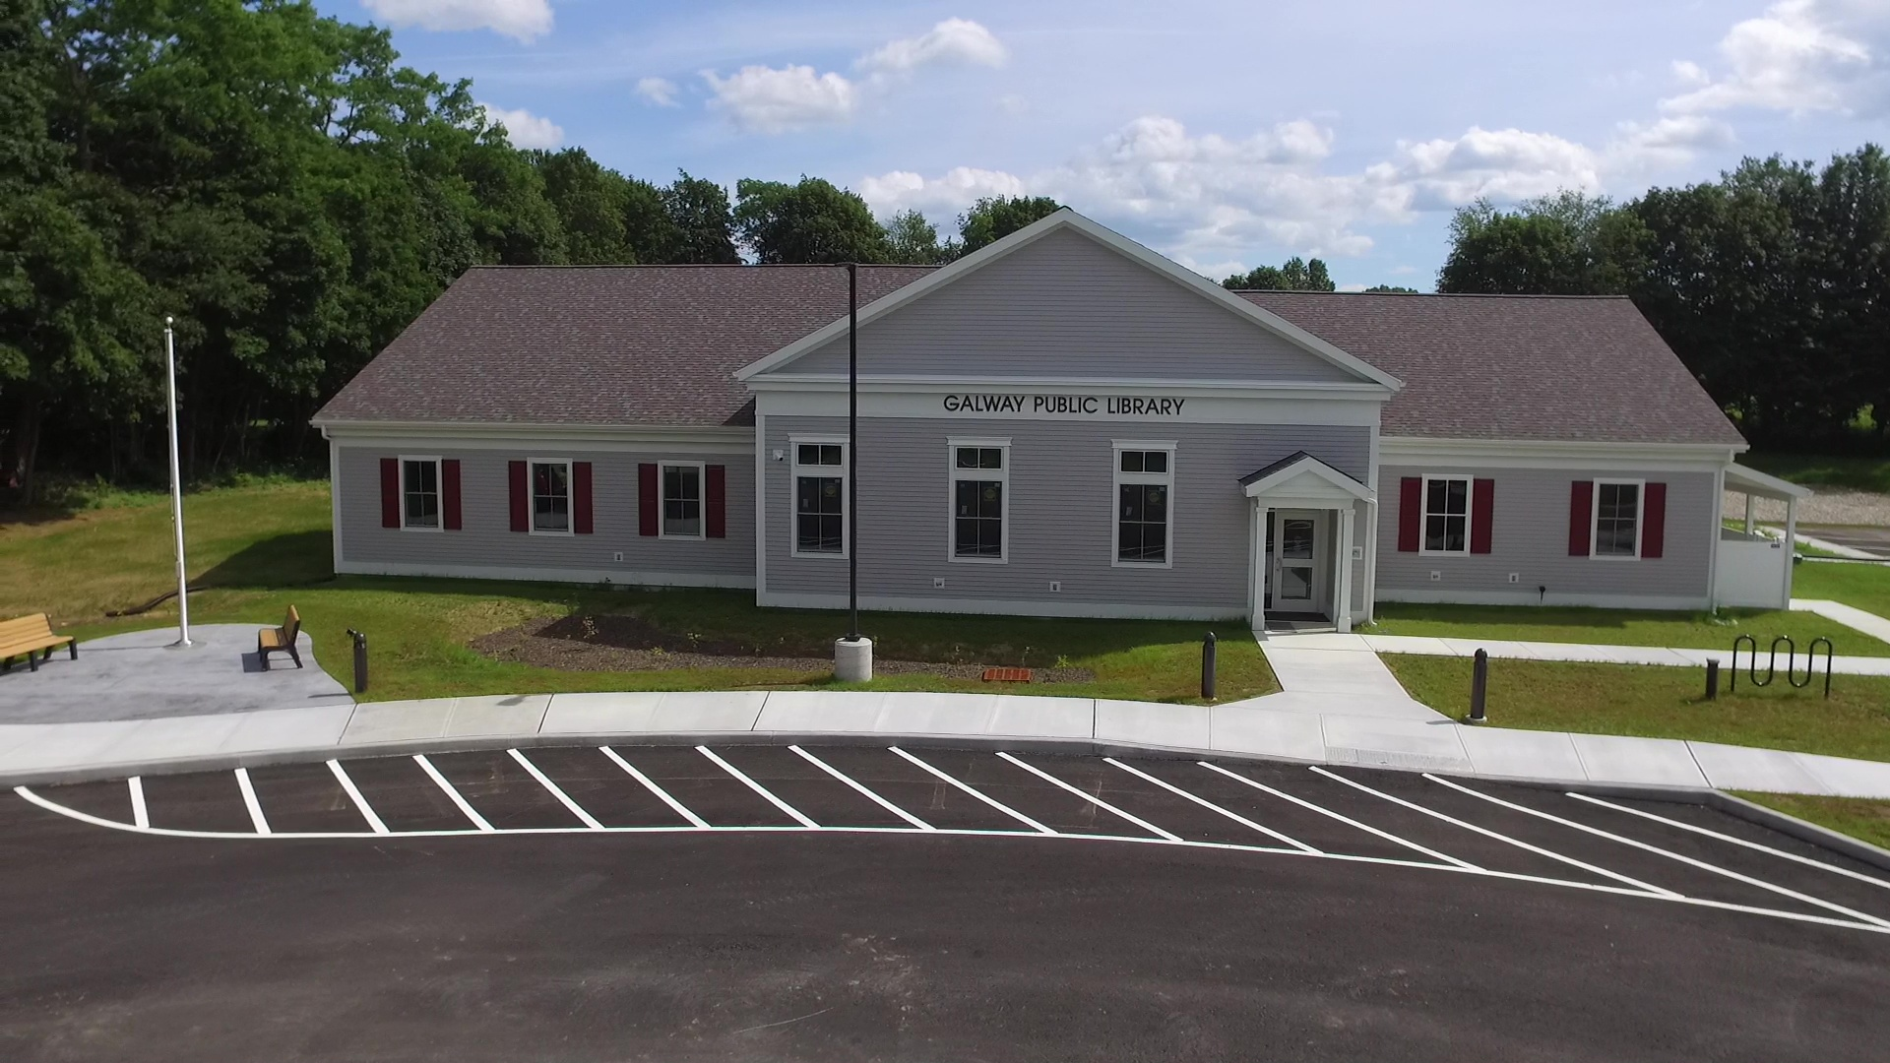
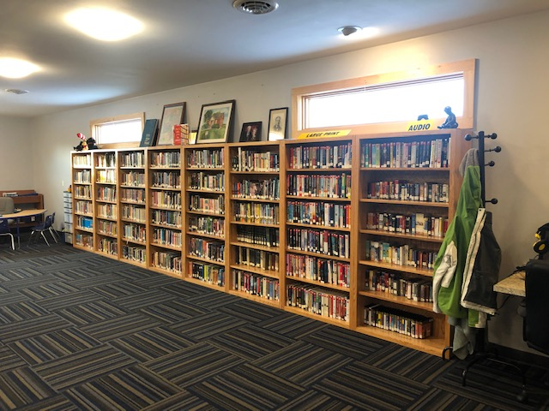
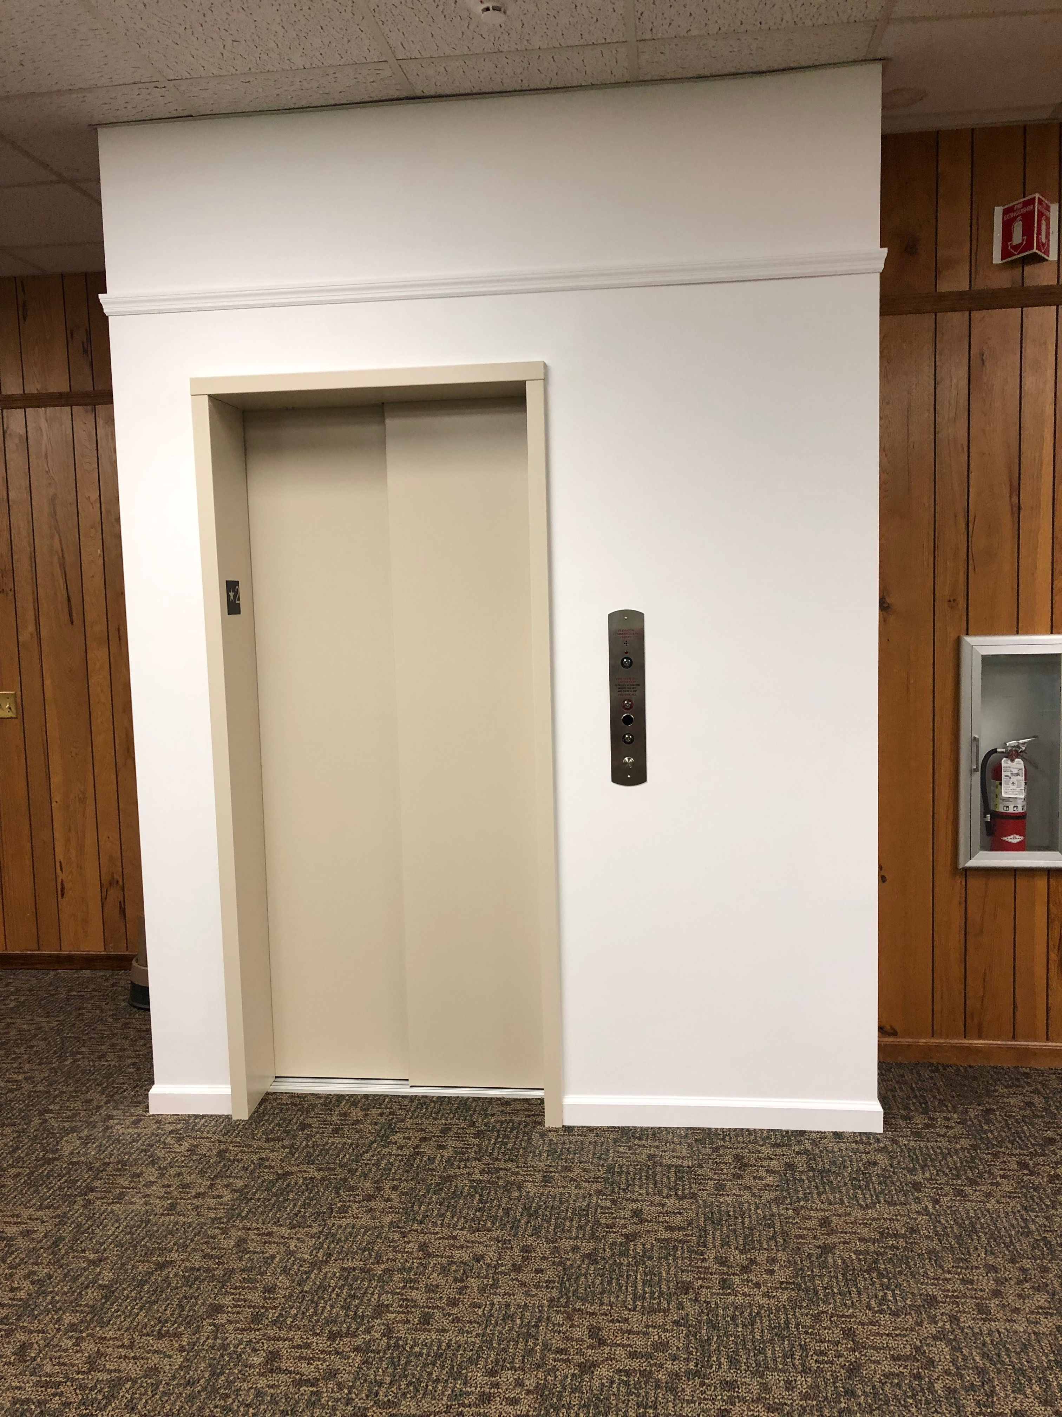
Recent Projects

